Slide 1

Welcome to our phonics workshop!

Slide 2
Phonics is taught daily for 20 minutes. (revisit, teach, apply, practise)
Phonics sessions are taught in classes with differentiated activities according to each individual child’s ability.

Slide 3
Reading
Individual sounds / phonemes – s,a,t,p,i,n,m,d,g,o…. Teach the sound the letter makes in a word, not primarily the letter name – alphabet (can cause confusion if both are taught at the same time)
Follow Jolly Phonics with the actions in the order of common used sounds.

Slide 4

Sounding out / blending
CVC (consonant, vowel, consonant) words e.g sit, pop, mat etc.
Each sound button makes one sound (above)
Say each sound
Close the gap
Hear then say the word

Slide 5
Digraphs
Two letters that make one sound
qu,sh,ch,th,th,oo, oo,ai,ee,oa,ar,oi,ur,ow,

Slide 6
Writing
Over writing
Letter formation
Pencil grip – pincer / tripod ( froggy fingers)

Slide 7
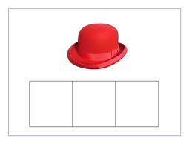
Segmenting (sounding out a word) and counting the sounds on fingers.

Slide 8
Now it’s your turn!
How many sounds are there in……..

Slide 9


Slide 11
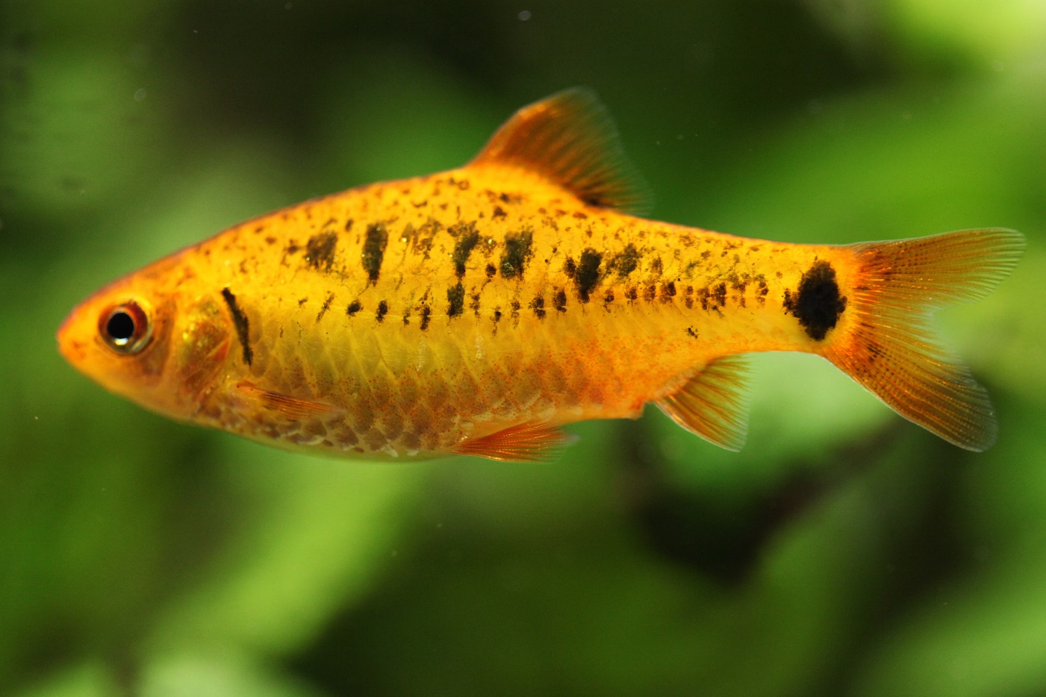

Slide 13

Tricky Words
“We can not sound them out, we have to learn them off by heart.”

Slide 14
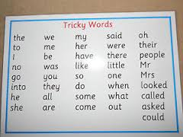

Slide 15
When is my child ready for a book with words?

Slide 16
What can you do to help your child at home?
Practise blending
Games
Share stories with discussions
Encourage children to make up their own stories
Looking at signs and sounds around the environment
Sound bags
Revisit

Slide 17
Frequently asked questions-
Homework – when do we have to complete it? How much is expected?
Lunchtimes – how much have they eaten? Have they drunk enough water today?
What is the behaviour system ? Fantastic Flower? Star of the week? Friday treat?
Routines – when are the children inside/outside? Do they have to ask to go to the toilet / get a drink?
Struggling to access remote learning?
What is Early Essence?

Slide 18
Thank you
Thank you to everyone for taking the time to attend this afternoon.
We will shortly be sending out a feedback questionnaire if you could kindly return that would be great.
As always if there is anything we can do to help / support please get in touch.
Copy of the presentation will be available on school website tomorrow.

