Slide 1
Geography
Watching this video clip can you guess what we are learning about today?
https://www.youtube.com/watch?v=WgktM2luLok

Slide 2
Discuss with your partner:
Do you know where the name ‘volcano’ came from?
Are there volcanos in East Africa, including Kenya?
What is a volcano?

Slide 3
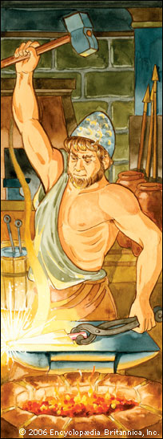
The name volcano is named after
the Roman God of fire – Vulcan.

Slide 4
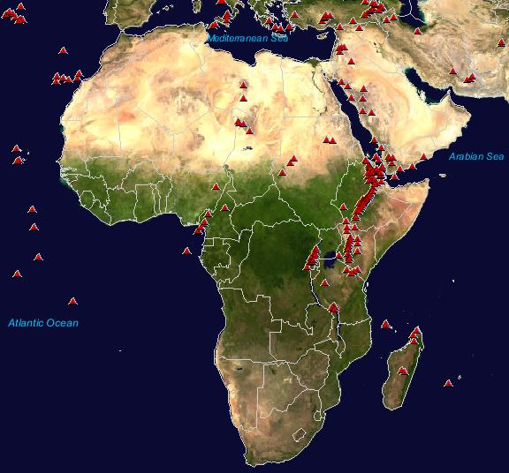
Yes there are volcanoes in east Africa, especially Kenya.

Slide 5
What is a volcano?
In today’s lesson you are going to understand what a volcano is, why it erupts and be able to label the different parts of a volcano successfully.

Slide 6
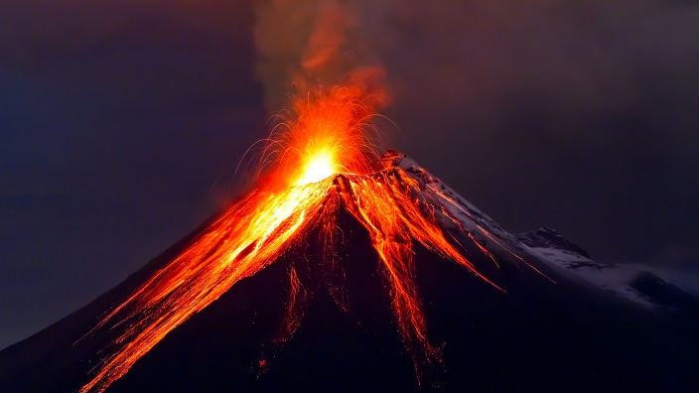
L.O: We are learning about key aspects of physical geography.
All can * use geographical language in order to label a diagram of a volcano.
Most can ** use geographical language to explain what happens when a volcano erupts.
Some can *** use geographical language to explain what happens when a volcano erupts with a written explanation of the process.

Slide 7
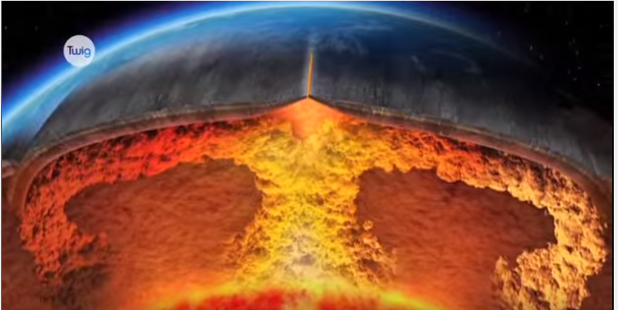
A volcano is an opening in the earth’s crust through which magma, ash and gas erupt.

Slide 8
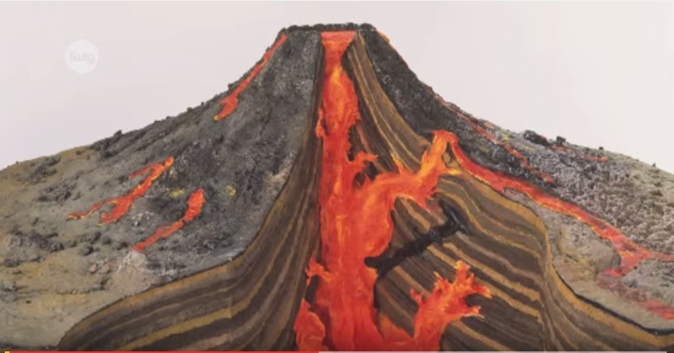
Rock under the earth’s surface is so hot that it melts. This melted rock is called magma. Heat rises so the magma moves towards the earths crust.

Slide 9
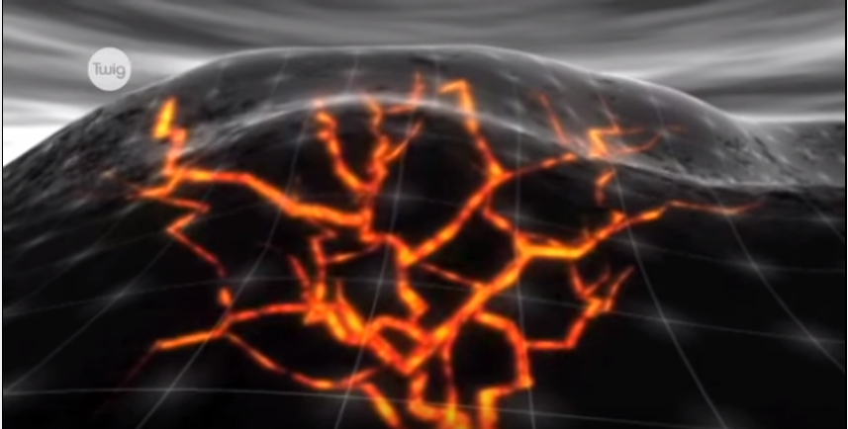
Sometimes it finds a crack or a hole in the earth’s crust and bursts through. This is when the pressure builds up under the surface causing a volcanic eruption.

Slide 10
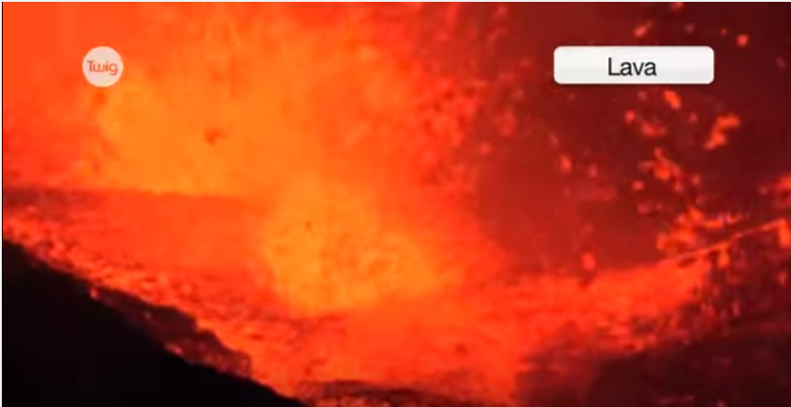
At the surface it erupts to form lava flows and ash deposits.
Erupting magma is called lava.

Slide 11
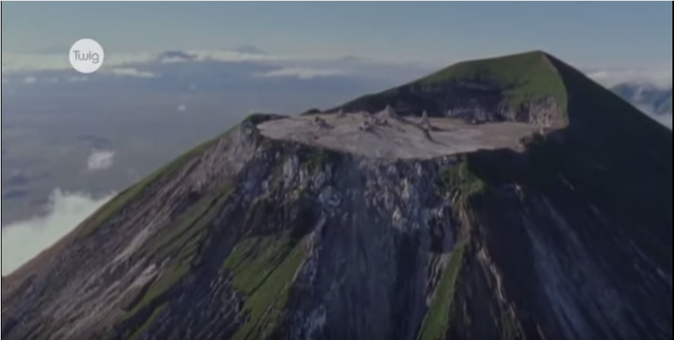
Volcanoes become bigger every time they erupt as the lava cools and makes a new layer of rock.

Slide 12
Did you know?
Volcanoes can erupt under water and form new islands from the cooled lava.
Volcanoes can be found on the Moon and other planets.
There are more than 500 active volcanoes on Earth, including Kenya!

Slide 13
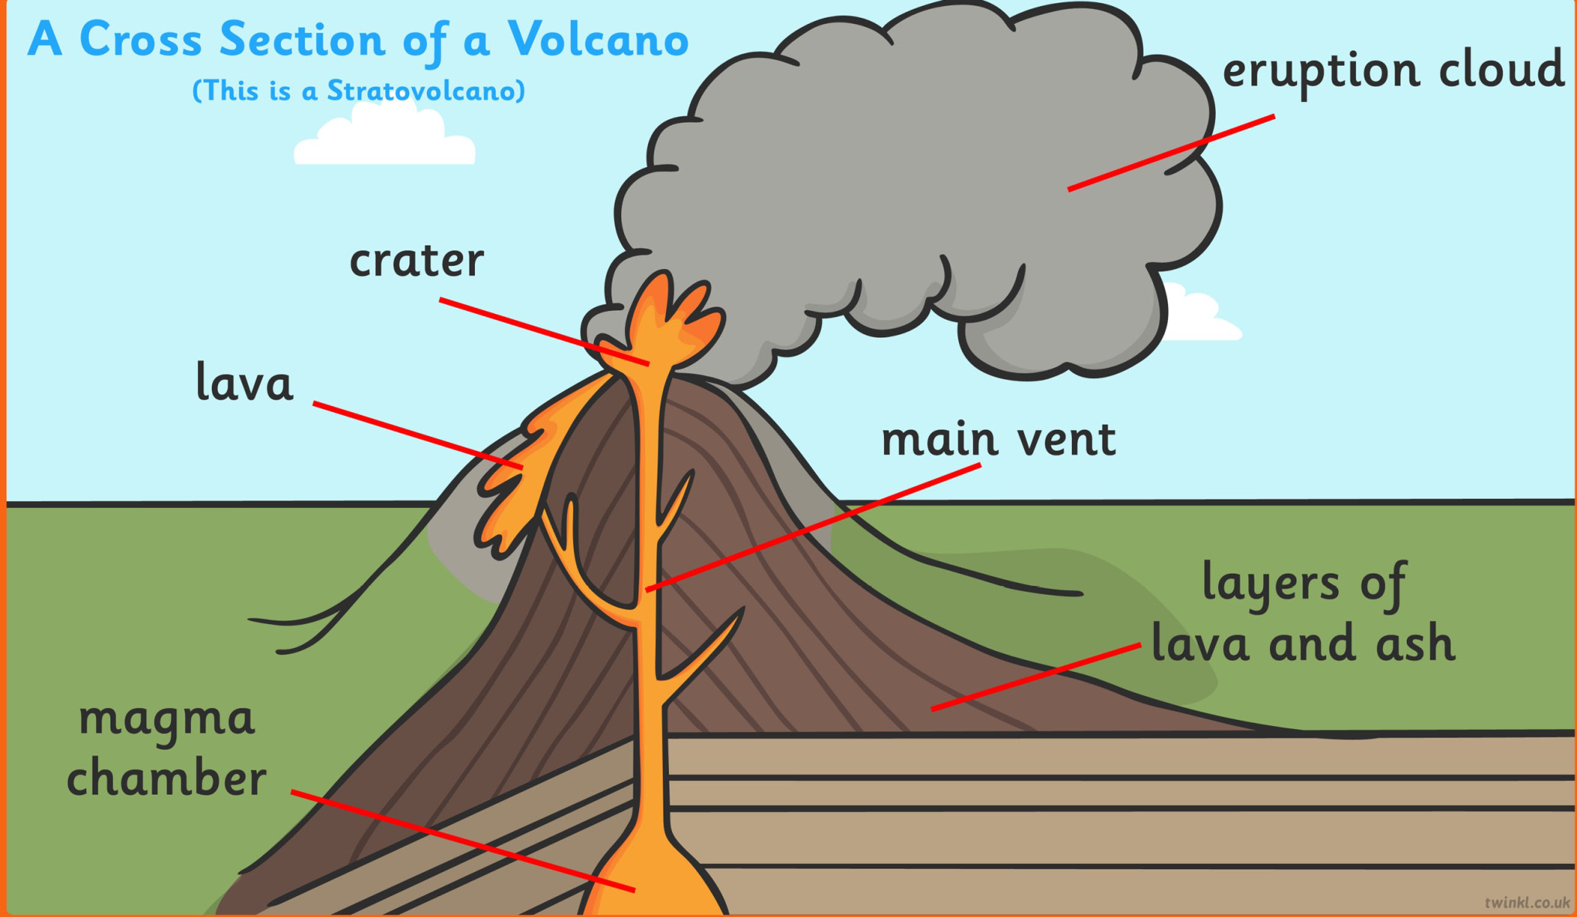

Slide 14
Now label you volcano!
Activity:
You may draw your own volcano or use the worksheet.
Remember to label the different parts correctly.
Use the previous slide to help if you need to.

Slide 15
Can you work out whether these facts are true or false?

Slide 16
True / False Volcano Facts.
1) False. A dormant volcano is ‘sleeping’ and may erupt again.
2) True. Lava is expelled from the volcano when it is active. This turns into the magma which when cooled makes up a layer of rock on the outside of the volcano.
3) True. The temperature of the lava can range from about 700 degrees celsius to about 1,600 degrees celsius. The temperature depends on the depth of the magma.
4) True. Volcanoes often produce spectacular scenery and therefore provide tourism. Many people have travelled to areas of volcanic activity for many centuries for activities as diverse as sightseeing, mountaineering, volcano boarding, camping as well as hot air balloon rides over the volcanic landforms.
5) True. The exact number of volcanoes is unknown as it depends on the exact definition of a volcano. During the past 10,000 years there are about 1,500 volcanoes on land that have been active, but the even larger number of submarine volcanoes is unknown. There are about 600 volcanoes that have had known eruptions during recorded history.

