Slide 1
PSHE and Citizenship
Relationships | Be Yourself
PSHE and Citizenship | Year 3 | Relationships | Be Yourself | Feelings | Lesson 2

Slide 2

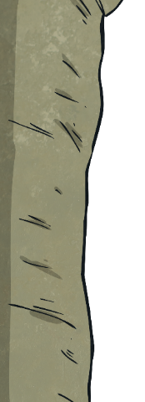
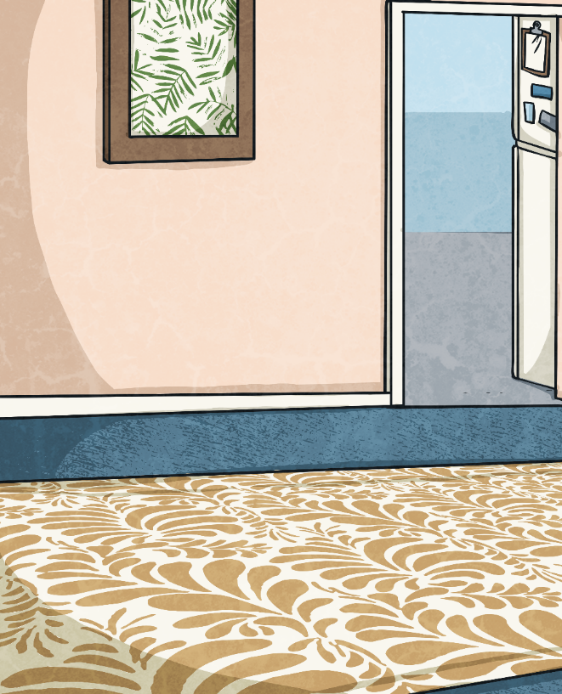
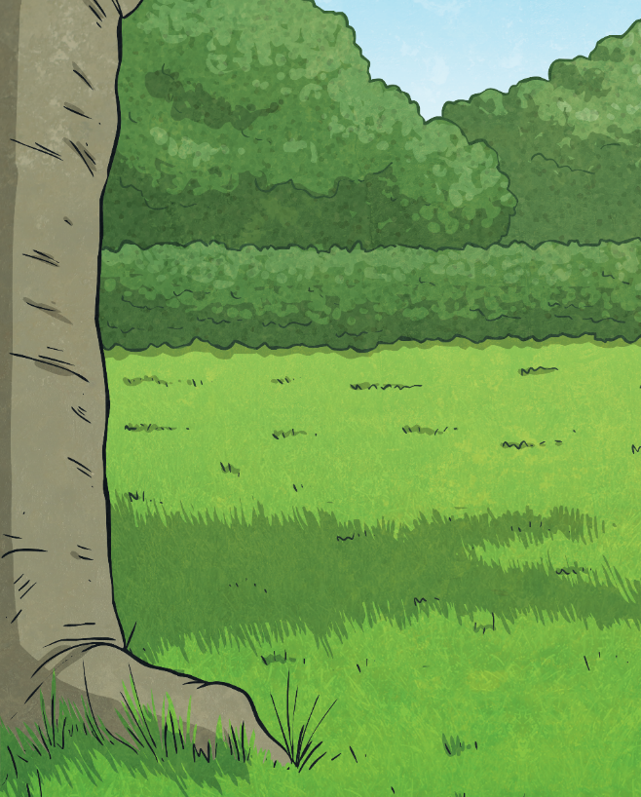
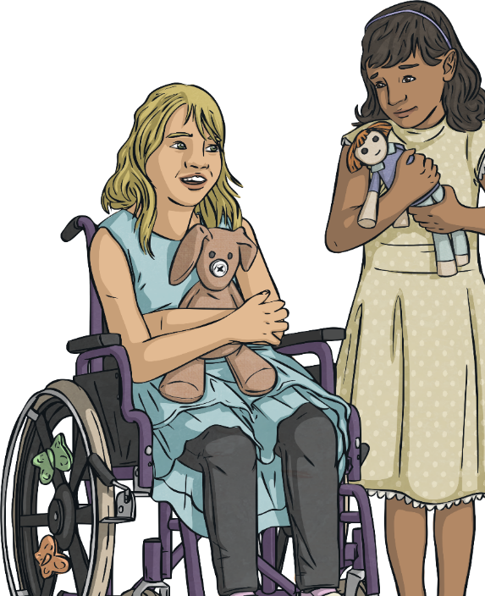
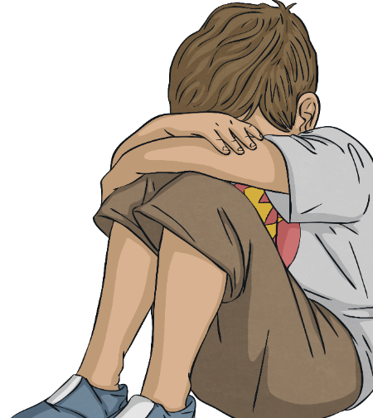
Comfortable and Uncomfortable
Which feelings do you find uncomfortable and which
do you find comfortable?
When might you feel the emotions below?
happiness
sadness
anxiety
nervousness
fear
excitement
Can you think of any different feelings and emotions? Are they comfortable or uncomfortable?
anger

Slide 3
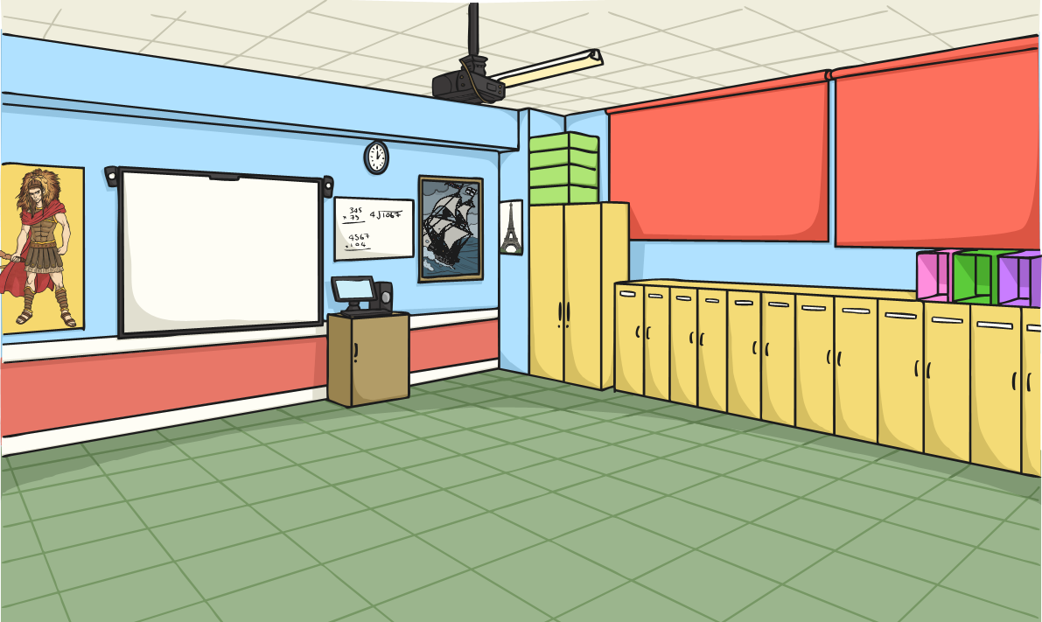
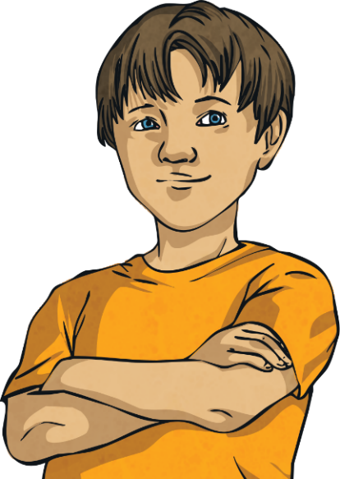
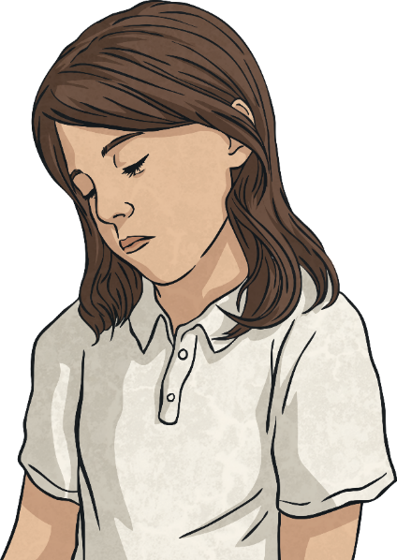
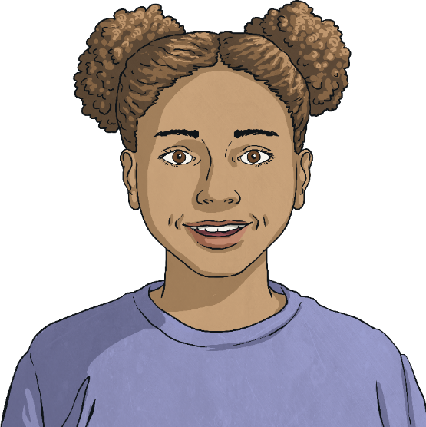
Comfortable and Uncomfortable
Sometimes big things might happen in our lives which can bring big changes to our situation. Change can be hard and these changes can result in uncomfortable and confusing feelings and emotions, all of which are completely normal and OK.
We experience lots of different feelings and emotions all in one day. This is because we experience lots of different situations all in one day.
Can you think what changes these could be?

Slide 4
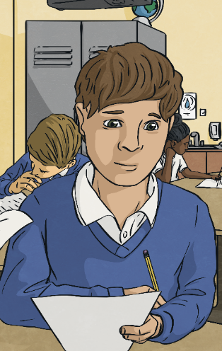
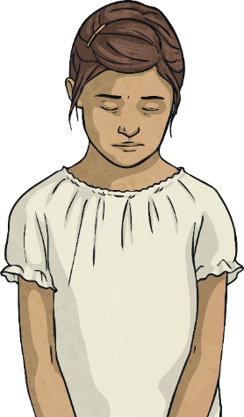
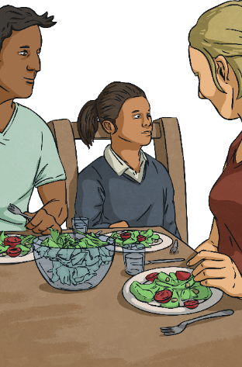
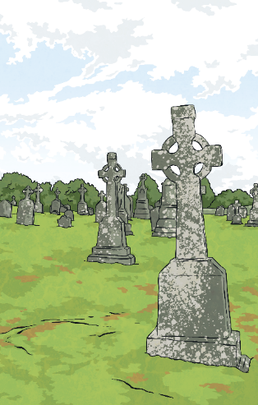
Comfortable and Uncomfortable
Starting a new school or a
new class.
Losing something that we love or has played a big part in our lives.
Families separating
or parents
getting divorced.
Someone or something that we love dying.

Slide 5
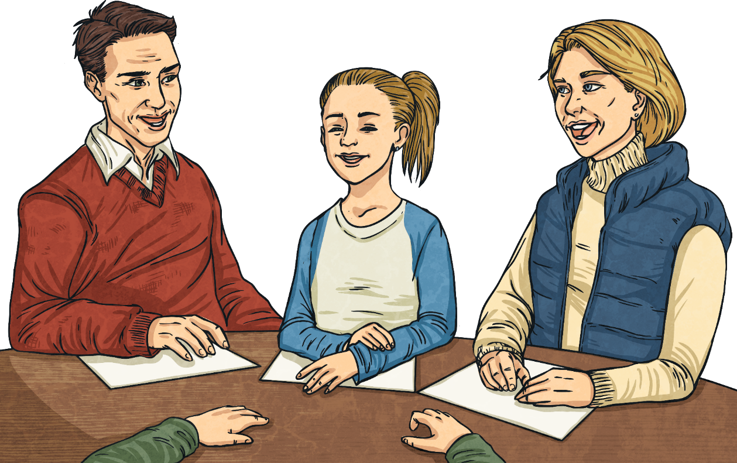
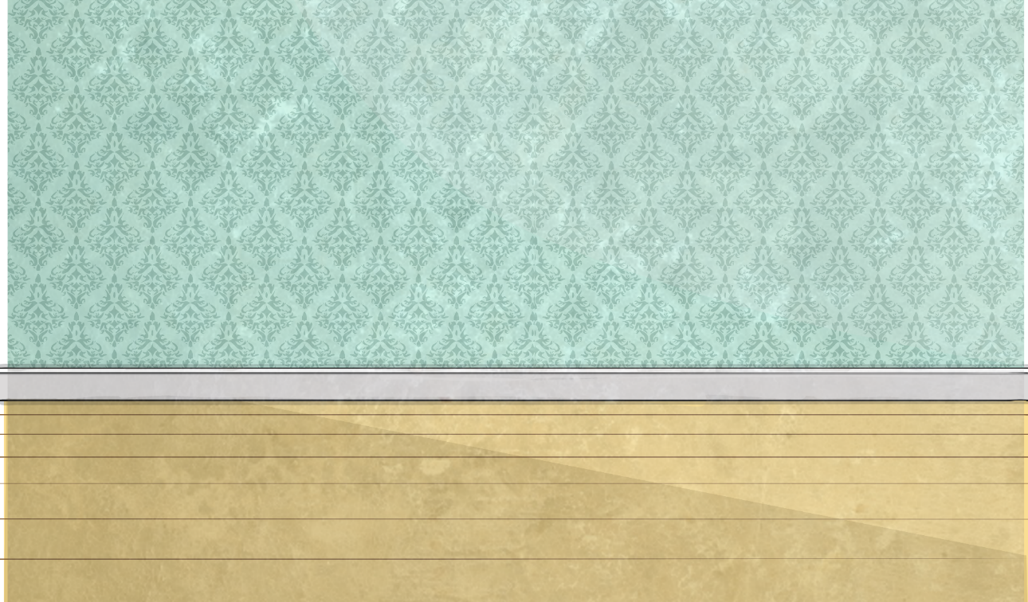
Comfortable and Uncomfortable
If you experience any big changes in your life which you are finding hard, talk to someone you trust about how you are feeling.
There are lots of people who can help you manage and deal with times of change and help you to feel calm and happy again.

Slide 6
Comfortable and Uncomfortable
We experience lots of different feelings, some of these are comfortable and some of these are not. It is important to remember that however we are feeling, that is OK. It is also important to remember to share how we are feeling with the special people in our lives.
When we understand our own feelings, we can begin to manage them. This means when we are beginning to feel an uncomfortable feeling, we can understand which feeling it is, why we are having it and what to do to help make it feel less uncomfortable. This can help our minds to be healthy too.
Reflecting
Consolidating

Slide 7
Consolidating

Slide 8

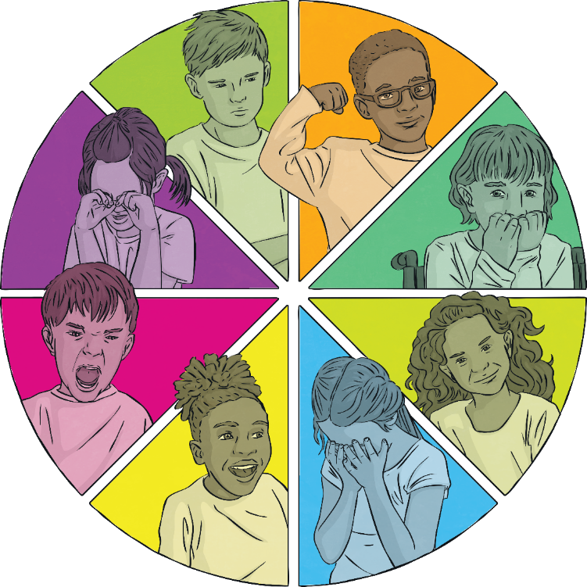
Emotions
How we are feeling can be
shown in lots of different ways.
Some artists show different
emotions through painting.
Your task is to create a piece of art, using colours and shapes, to show an emotion of your choice.
Which colour do
you think could
show anger?
Which colour do
you think could
show happiness?
Which shapes would show excitement?
Your art work could show how you might feel after a big event or change has happened, or just an emotion that you might experience on an ordinary day.

Slide 9
Reflecting

Slide 10

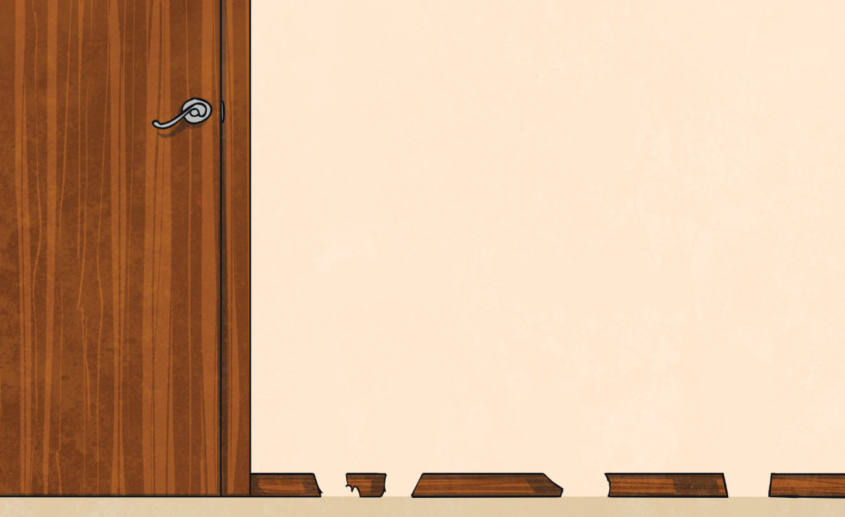
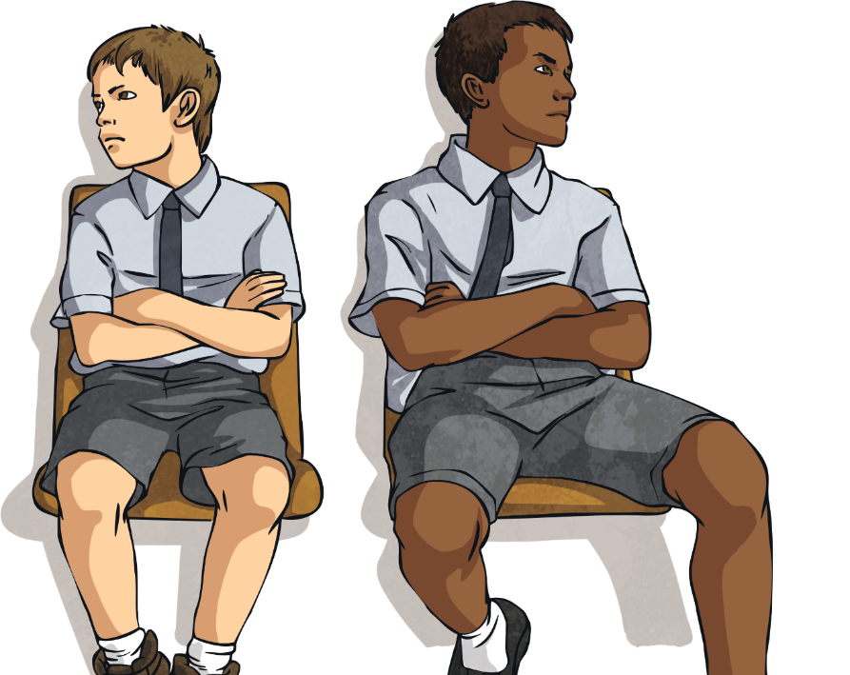
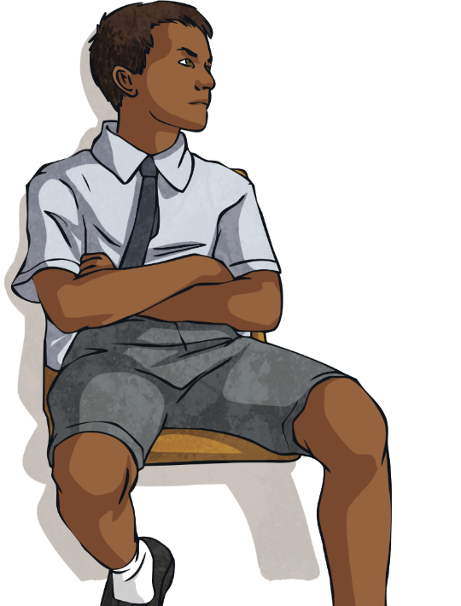
Being around Emotions
How does it feel to be around people when they are experiencing different emotions?
Talk about this in your groups and then share your thoughts with the class.

Slide 11
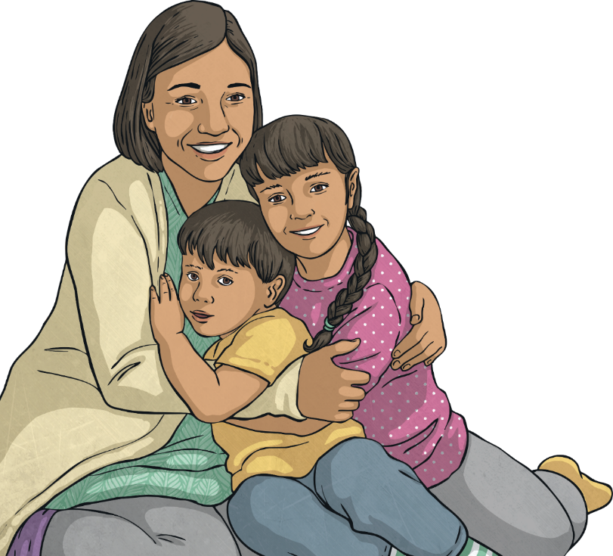
Being around Emotions
How would we like other people to treat us when we are experiencing different feelings and emotions?
Talk about this in your groups and then share your thoughts with the class.
Let’s be a class that
looks after the feelings
of others, always!

Slide 12
The Big Questions

Slide 13

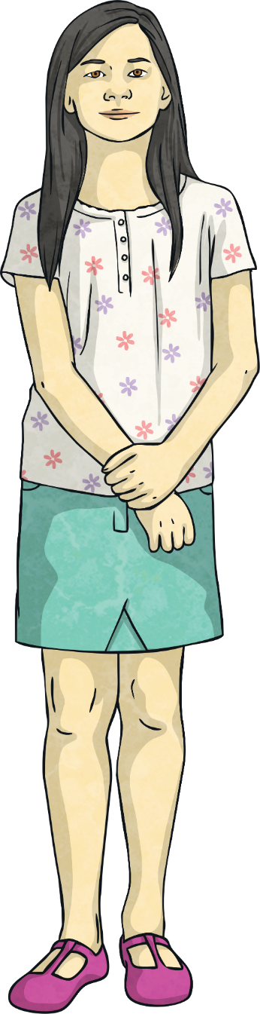
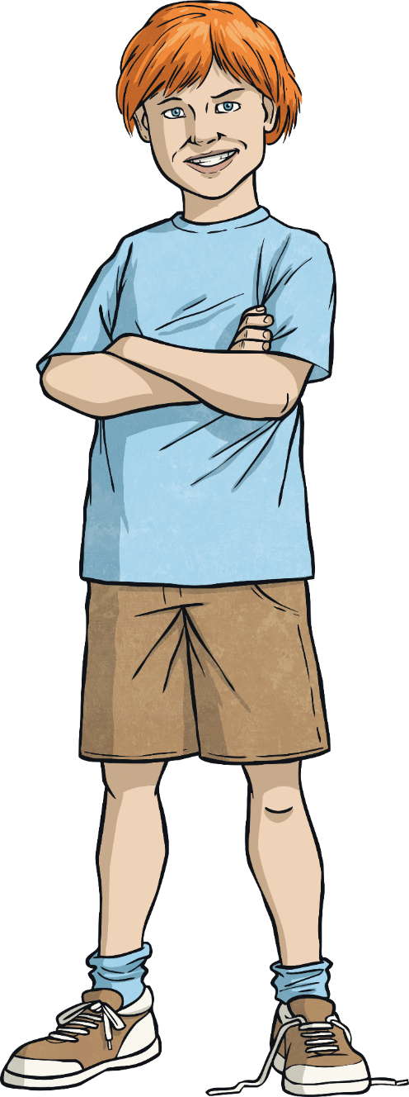
The Big Questions
What are our main feelings and emotions called?
What do they feel like?
When might these
feelings happen?
What have you learnt today that is going to help you in your daily life?

Slide 14
Aim
I can identify the feelings I have and describe how different
emotions feel.
Success Criteria
I can show understanding of different feelings.
I can identify how emotions felt on the inside might look
on the outside.
I can explore the different times I experience certain feelings.
I can reflect on how I can support others when they are experiencing different emotions.

