Slide 1
PSHE and Citizenship
Relationships | Be Yourself
PSHE and Citizenship | Year 3 | Relationships | Be Yourself | Feelings | Lesson 2

Slide 3
Aim
I can identify the feelings I have and describe how different
emotions feel.
Success Criteria
I can show understanding of different feelings.
I can identify how emotions felt on the inside might look
on the outside.
I can explore the different times I experience certain feelings.
I can reflect on how I can support others when they are experiencing different emotions.
This resource is fully in line with the Learning Outcomes and Core Themes outlined in the PSHE Association’s Programme of Study.

Slide 4
The Big Questions

Slide 5

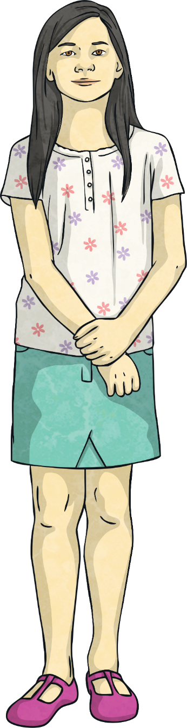
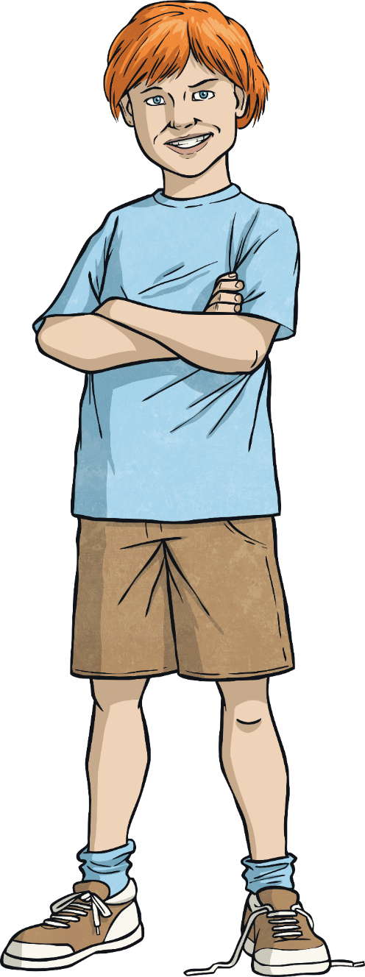
The Big Questions
What are our main feelings and emotions called?
What do they feel like?
When might these
feelings happen?

Slide 6
Reconnecting

Slide 7


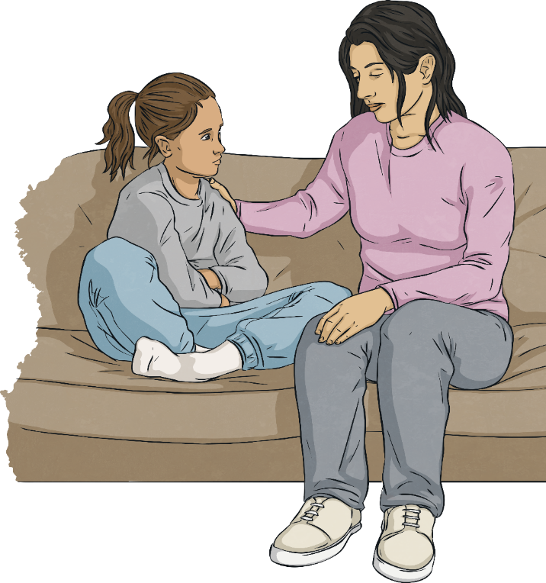
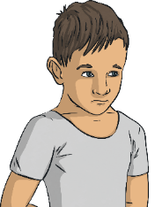
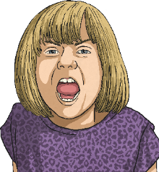
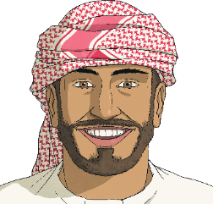
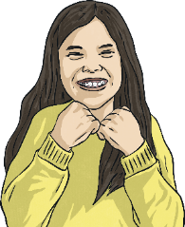
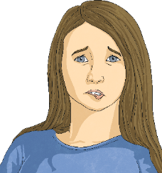
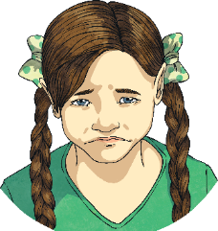
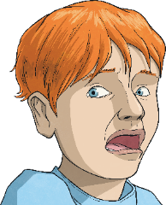
Match the Feeling
Here are just a few of the different ways we may feel…
Can you match the description to the correct feeling? Work with a partner to do this.
We experience lots of different feelings, some of these are comfortable and some of
these are not. It is important
to remember that however we
are feeling, that is OK. It is also important to remember to share how we are feeling with the special people in our lives.
When you very feel frightened about something.
When you feel
anxious or uneasy about something.
When you feel
annoyed or angry about something.
When life feels
good and you just
want to smile.
When you feel sensitive and agitated easily by things. You may feel like you have butterflies in your tummy.
When something is upsetting you and making you unhappy.
When you feel very enthusiastic and keen to do something.
scared
worried
cross
happy
nervous
sad
excited

Slide 8

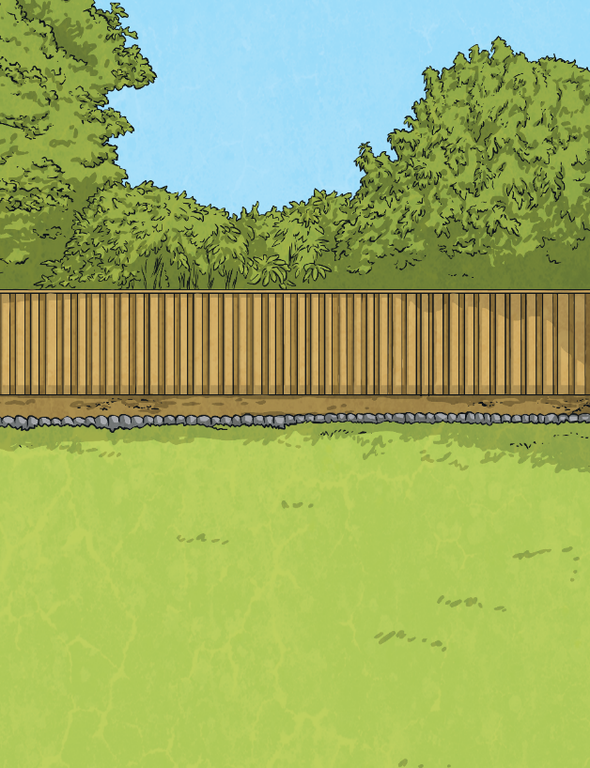
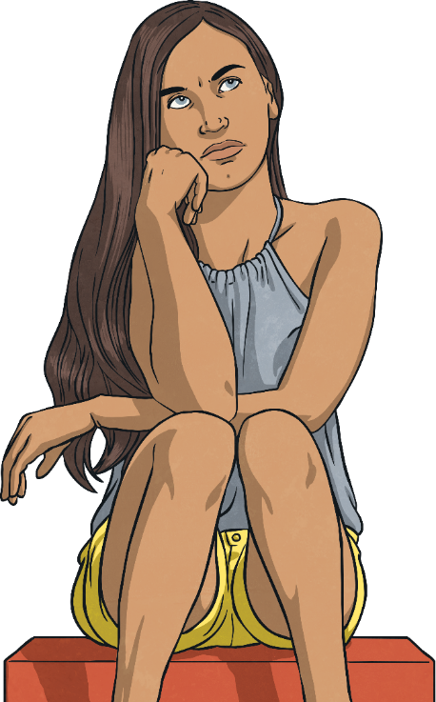
Match the Feeling
Why do we give our feelings names and labels?
We can easily identify our feelings if they have names and labels. This can help us to manage our emotions and our reactions to them. Giving feelings names and labels also helps us to understand the behaviour of others.
We can then show understanding and kindness when someone is feeling a particular way. For example, if one of our friends saw us crying, they would know that crying means we are feeling sad. This then means they can ask us what is wrong and try to help us.

Slide 9
Exploring

Slide 10
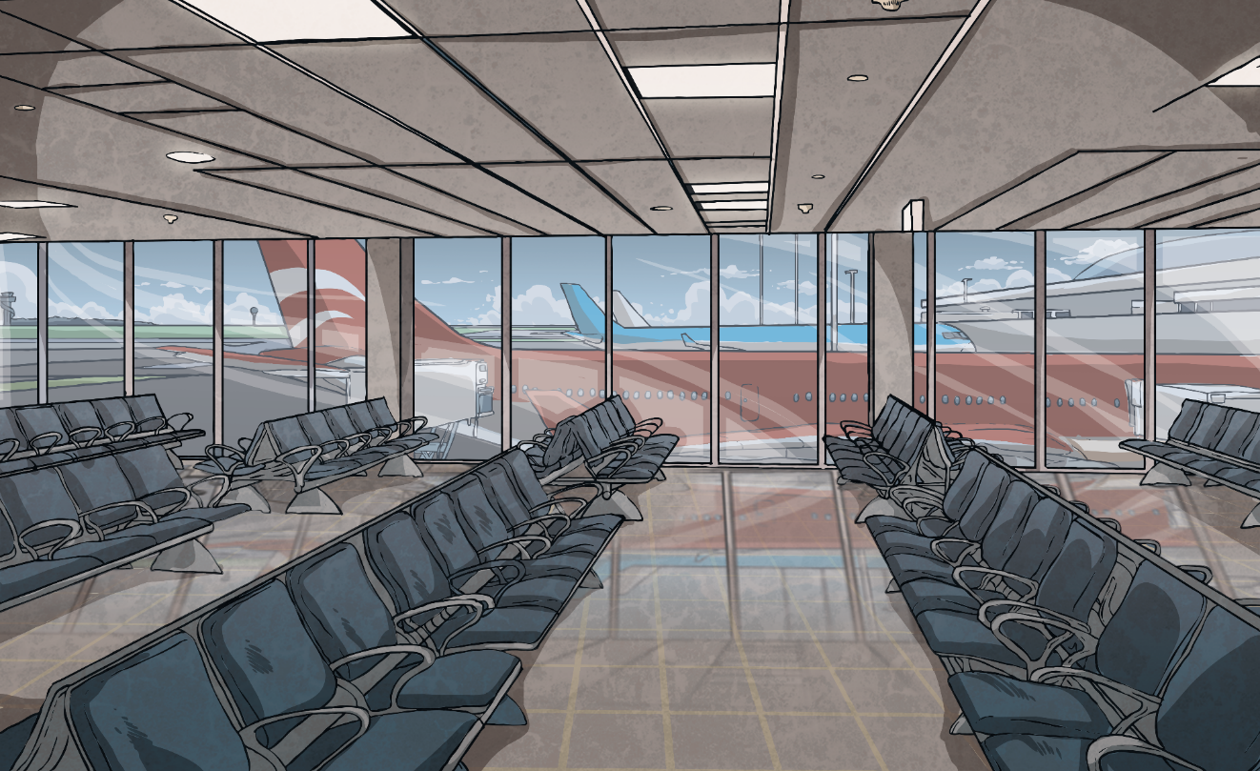
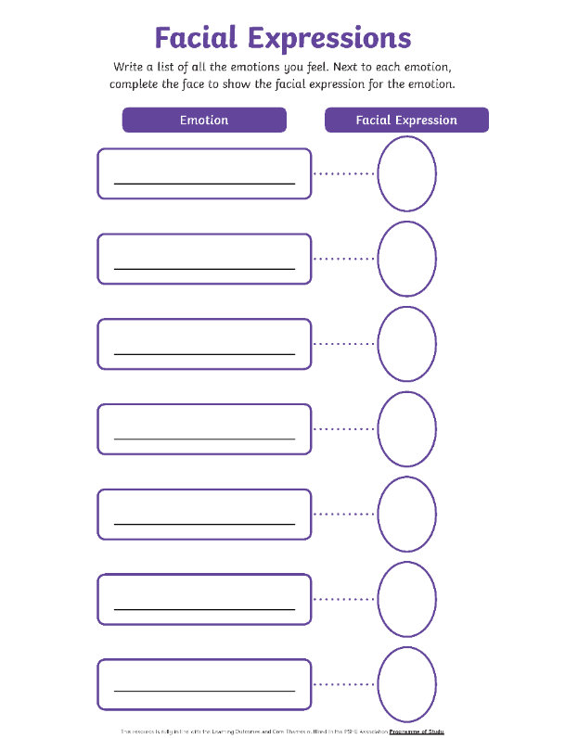
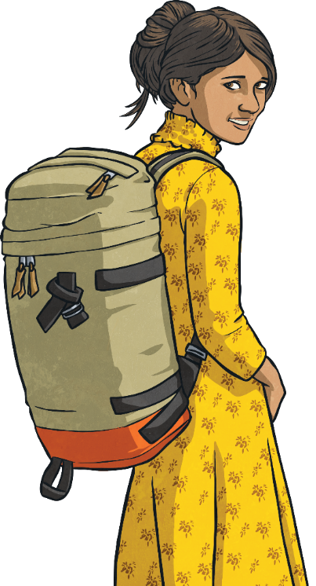

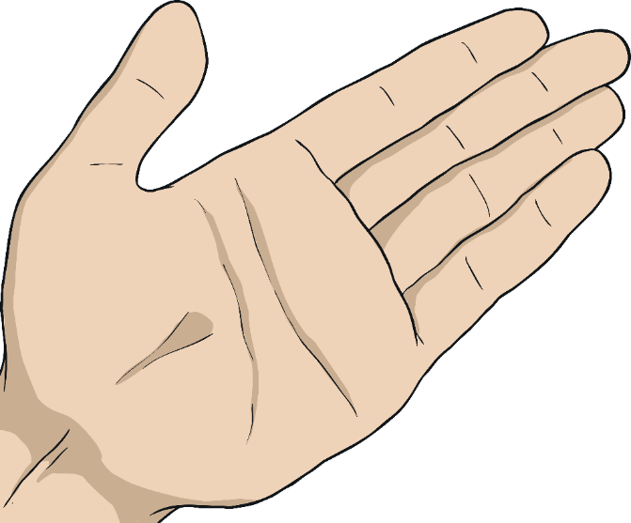

Facial Expressions
In pairs, create a list of all the feelings and emotions
you know on the Facial Expressions Activity Sheet. Next to each one, draw a picture to show what the person experiencing that feeling and emotion might look like on the outside.
The different emotions we experience make us feel different things on the inside. How we are feeling on the inside can sometimes be seen on the outside, through our body language and our facial expressions.

Slide 11
Consolidating

Slide 12

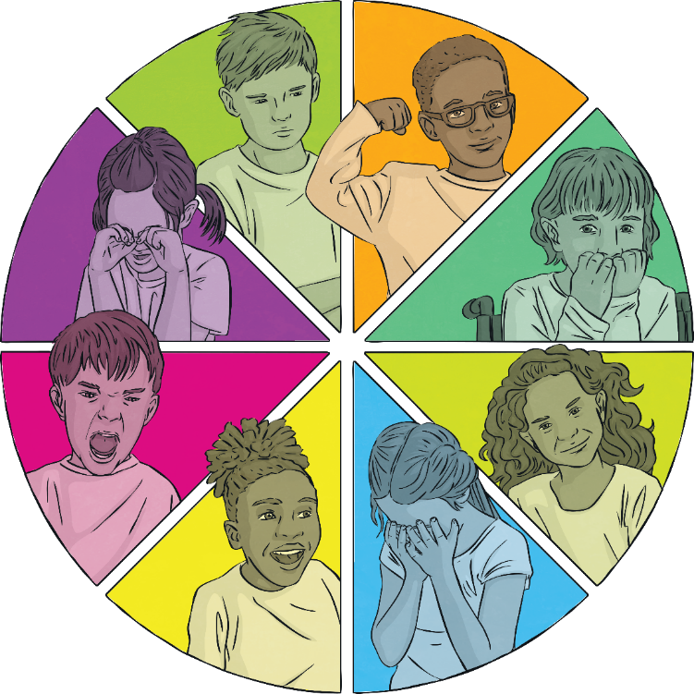
Emotions
How we are feeling can be
shown in lots of different ways.
Some artists show different
emotions through painting.
Your task is to create a piece of art, using colours and shapes, to show an emotion of your choice.
Which colour do
you think could
show anger?
Which colour do
you think could
show happiness?
Which shapes would show excitement?
Your art work could show how you might feel after a big event or change has happened, or just an emotion that you might experience on an ordinary day.

Slide 13
The Big Questions

Slide 14
The Big Questions
What are our main feelings and emotions called?
What do they feel like?
When might these
feelings happen?
What have you learnt today that is going to help you in your daily life?

Slide 15
Aim
I can identify the feelings I have and describe how different
emotions feel.
Success Criteria
I can show understanding of different feelings.
I can identify how emotions felt on the inside might look
on the outside.
I can explore the different times I experience certain feelings.
I can reflect on how I can support others when they are experiencing different emotions.

