Slide 1

Science
Properties and Changes of Materials
Year One
Science | Year 5 | Properties and Changes of Materials | Brighter Bulbs | Lesson 3

Slide 2
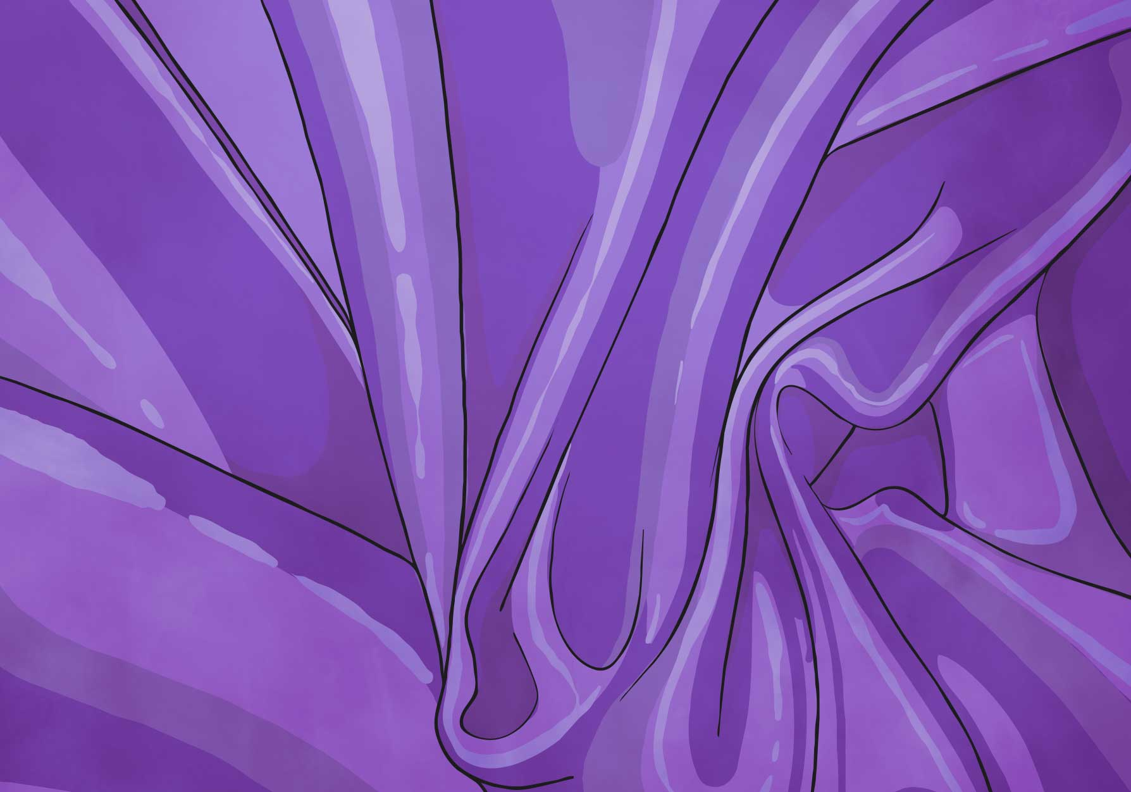

Brighter Bulbs

Slide 3
Aim
I can investigate which electrical conductors make a bulb shine brightest.
Success Criteria
I can identify electrical conductors and insulators.
I can explain that some materials are better conductors than others.

Slide 4
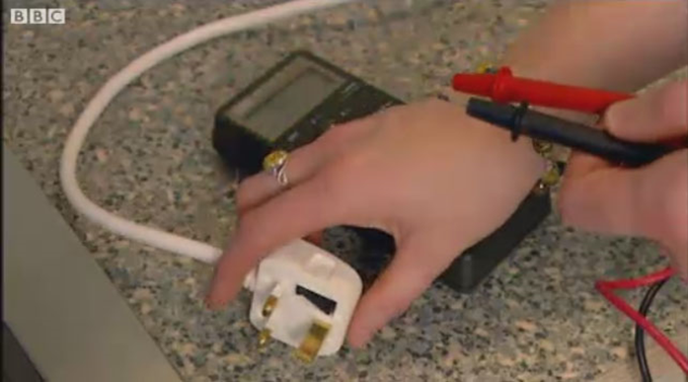

Electrical Conductors and Insulators
Electricity can travel easily through electrical conductors,
but some materials do not let electricity pass through them.
These are known as electrical insulators.
Watch this clip to see some materials that are
electrical conductors or insulators.

Slide 5
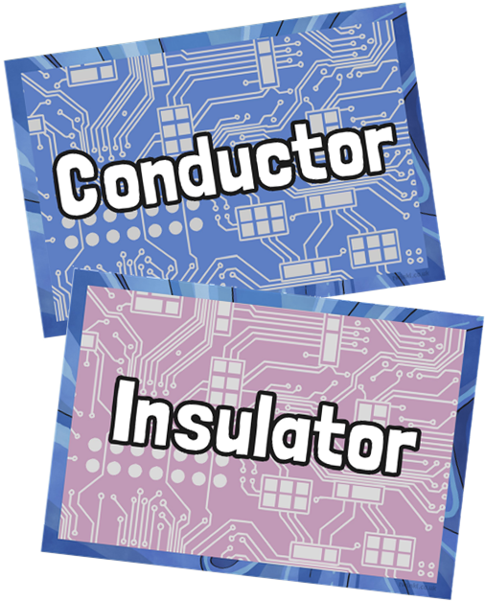
Electrical Conductors and Insulators
We know that metals are electrical conductors, but which other materials conduct electricity?
Your task - Can you guess if the following materials are conductors or insulators?

Slide 6
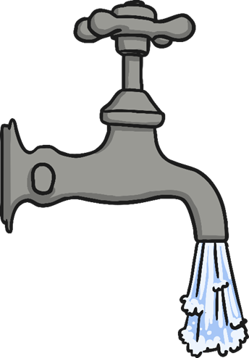
Electrical Conductors and Insulators
Tap water
Electrical Conductor

Slide 7
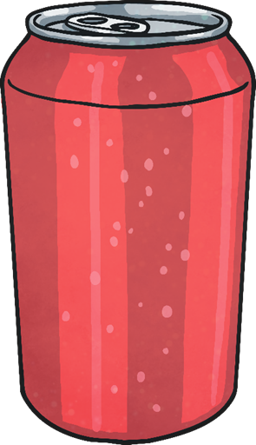
Electrical Conductors and Insulators
Drinks Can
Electrical Conductor

Slide 8

Electrical Conductors and Insulators
Paper
Electrical Insulator

Slide 9
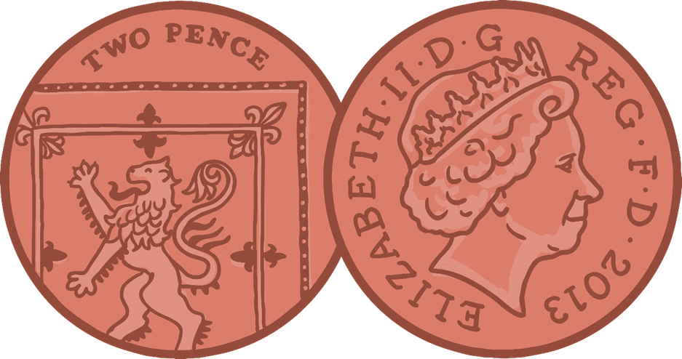
Electrical Conductors and Insulators
2p Coin
Electrical Conductor

Slide 10

Electrical Conductors and Insulators
Rubber Gloves
Electrical Insulator

Slide 11
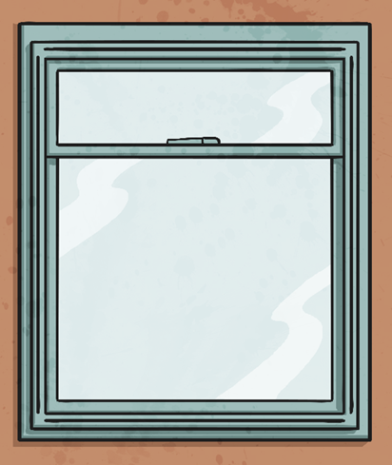
Electrical Conductors and Insulators
Glass Window
Electrical Insulator

Slide 12
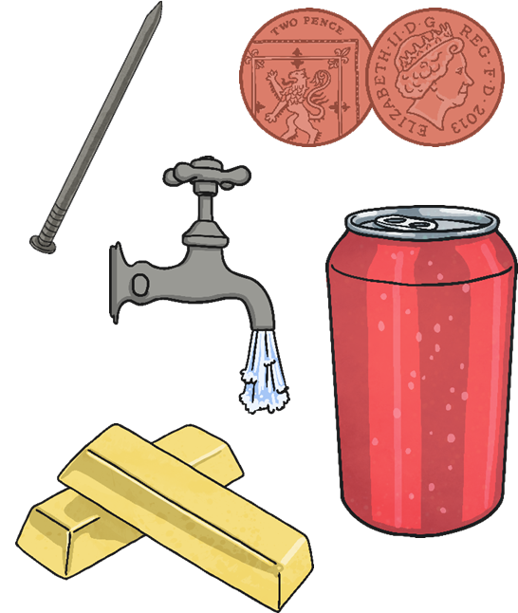
Conductors and Resistance
These items are all electrical conductors.
Some conductors make it easier for electricity to pass through them than others.
All materials have some electrical resistance.
Resistance is the opposition to the flow of electricity through a material.
Electrical insulators have a very high resistance and it is very hard for electricity to travel through these objects.
Electrical conductors have very low resistance and it is very easy for electricity to pass through them.
Different conductors have different levels of resistance, so even through they can all conduct electricity, some allow electricity to flow through easier than others.

Slide 13
Conductors and insulators video and game…
Using the link below, watch the video, read the information, then have a go at the game!
https://www.bbc.co.uk/bitesize/topics/z2882hv/articles/zxv482p

Slide 14

Aim
I can investigate which electrical conductors make a bulb shine brightest.
Success Criteria
I can identify electrical conductors and insulators.
I can explain that some materials are better conductors than others.

