Slide 1
Gilgamesh and enkidu
Can I create a character description?

Slide 2
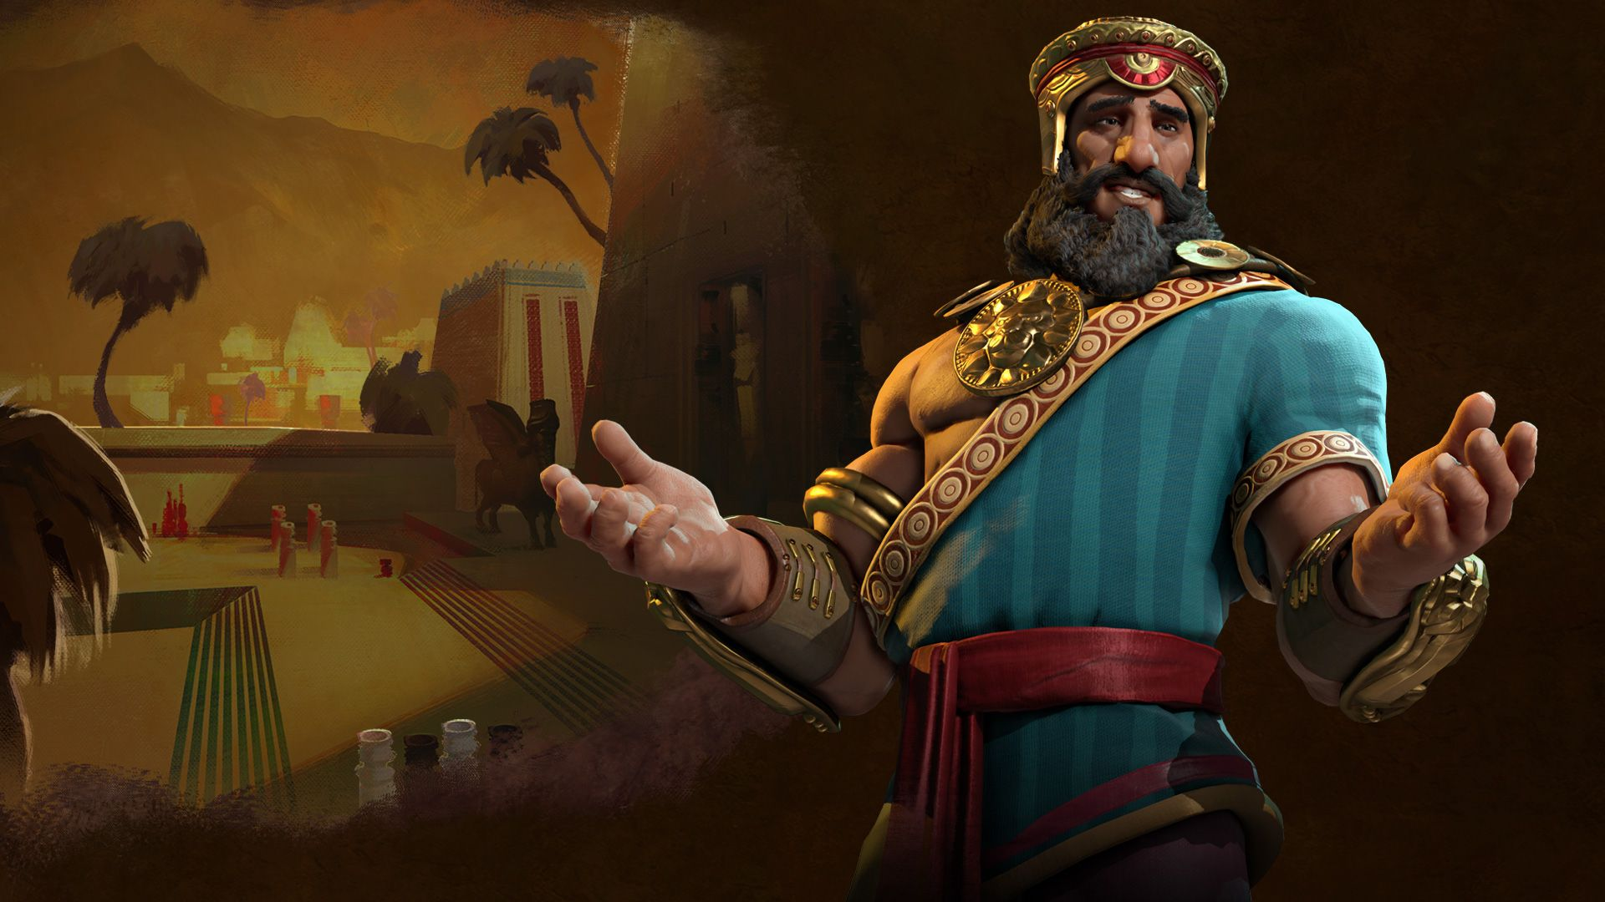
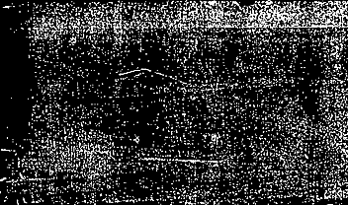
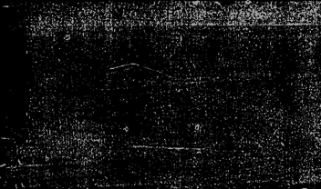
gilgamesh
2/3 God, 1/3 Human
His mother was a goddess, his father was mortal.
He was pretty horrible to everyone to start off with.

Slide 3
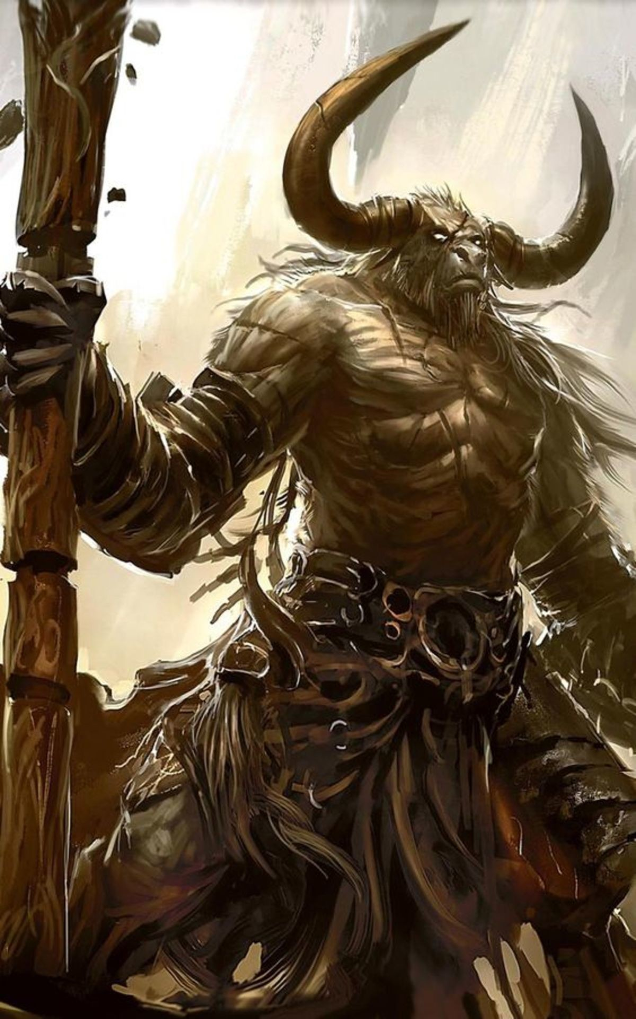
Enkidu
Was made out of clay and water by Aruru (goddess of creation), to rid Gilgamesh of his arrogance.
Possibly half-man, half-bull.
Equal in strength to Gilgamesh.
He acts with more tolerance and kindness than Gilgamesh.

Slide 4


Your task……
Can you create a character description and your own picture of either Gilgamesh or Enkidu?

Slide 5
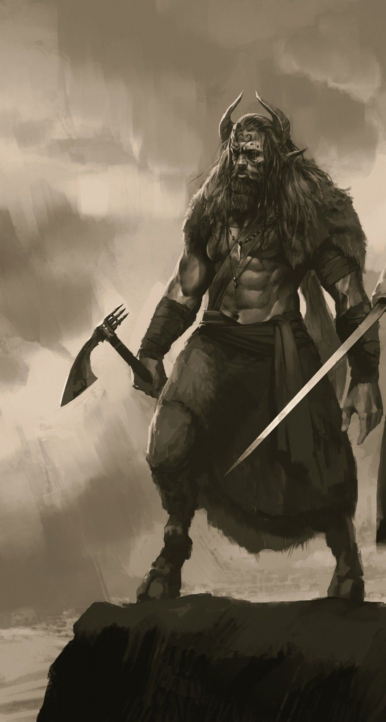
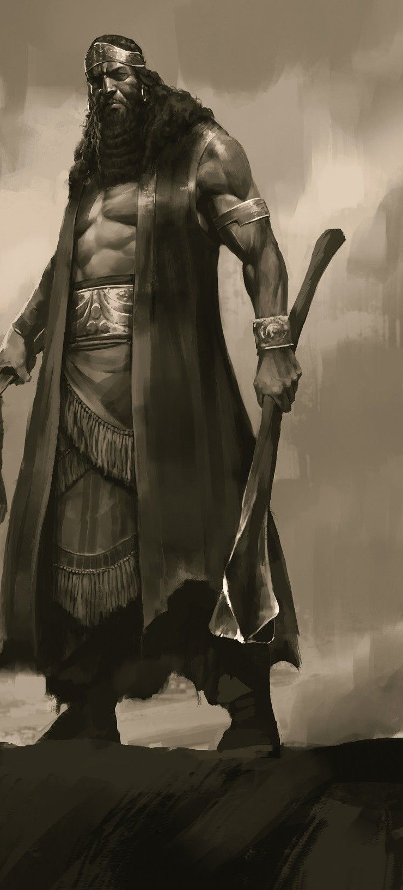
Enkidu or Gilgamesh?
When you are writing your character description consider how they are described in the story to help write about their personalities!

