Slide 1
The Cat and the Mouse
Can I create a comic strip retelling a story?

Slide 2
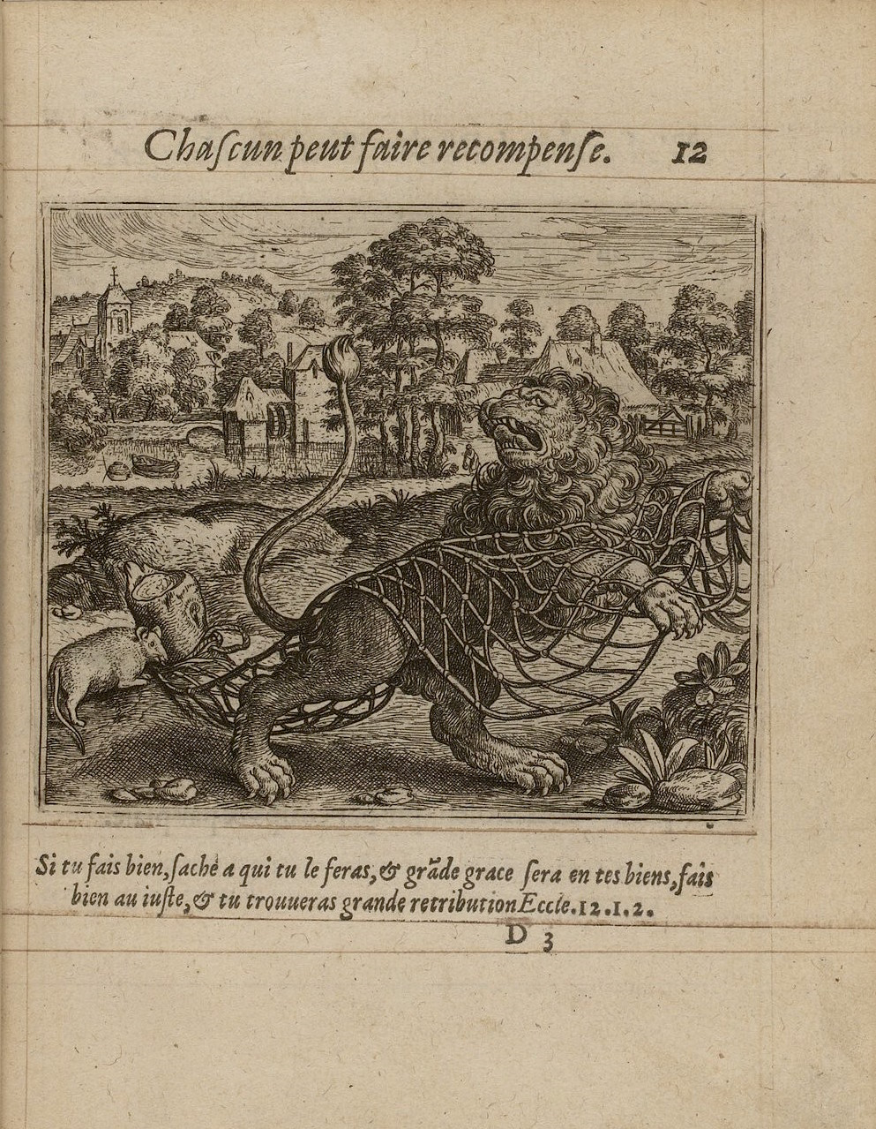
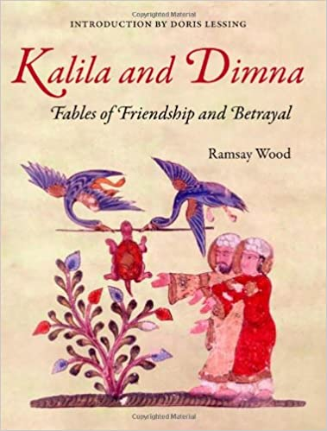
This is a story from Kililah and Dimnah

Slide 3
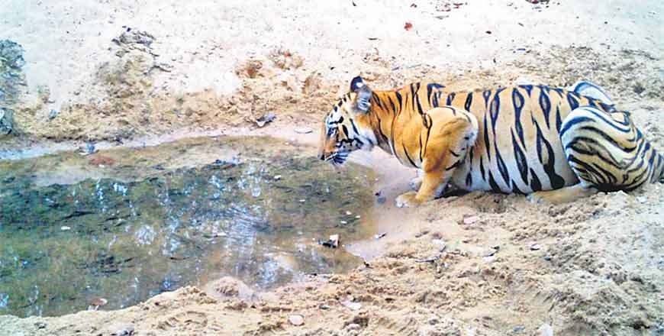
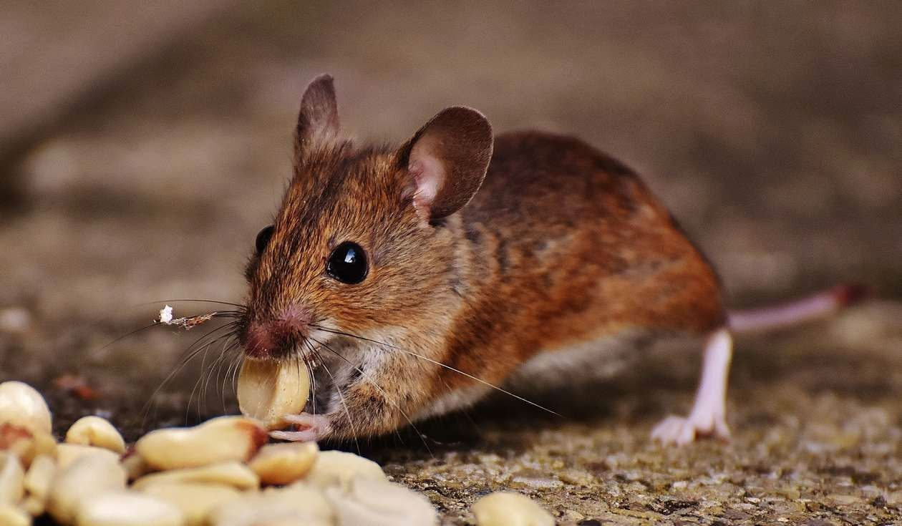
The characters in this fable were the wildcat, Rami, and the mouse, Qaridun, and the story takes place under a lofty tree where the two creatures lived.
The cat, Rami, had left his lair and was caught in a snare in a glade by the tree.
The mouse, Qaridun, was outside his hole searching for food.

Slide 4
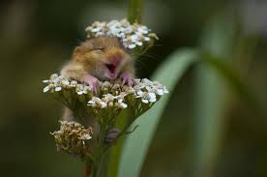
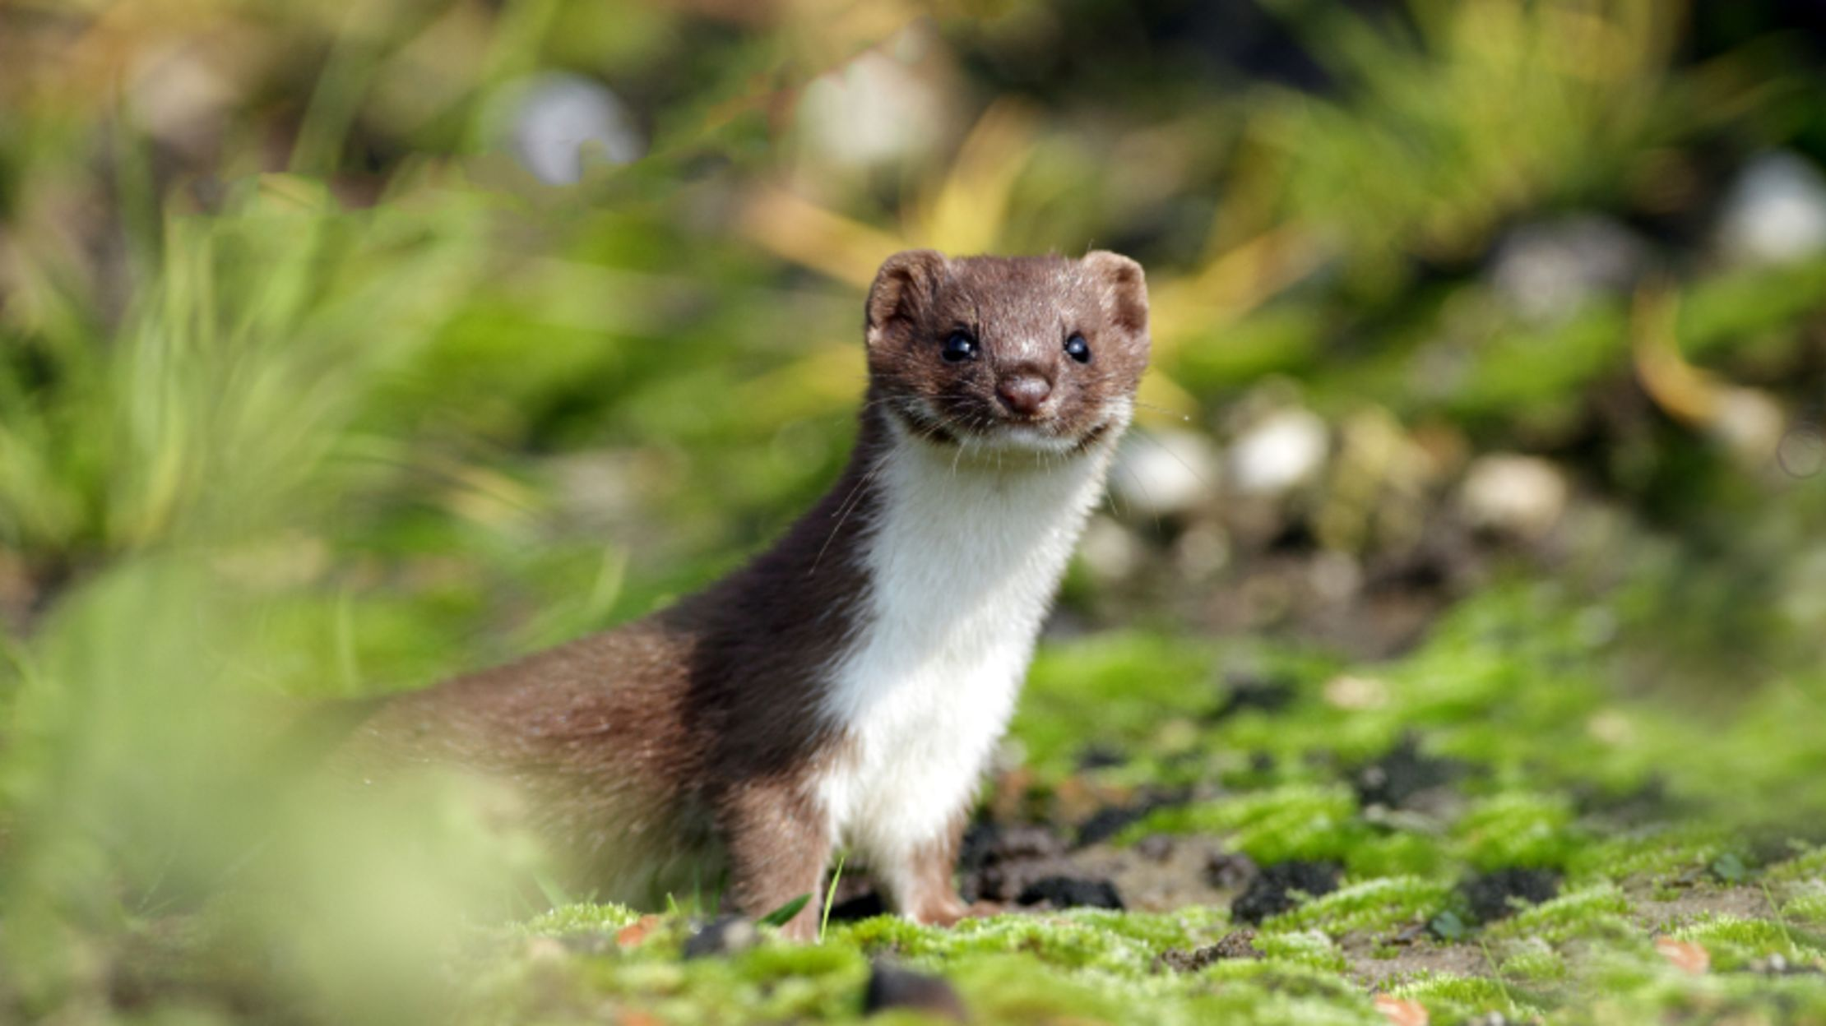
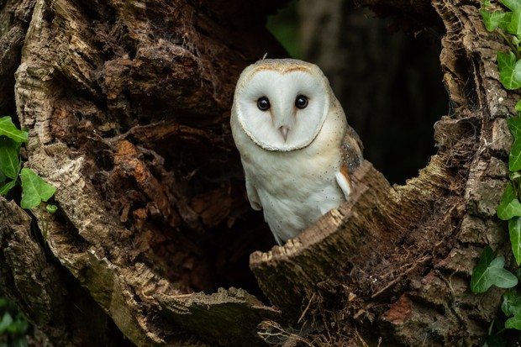
Qaridun was glad when he saw the cat caught in the snare.
He then looked all around and noticed that a weasel was stalking him from behind and an owl was watching him from above in the tree.

Slide 5
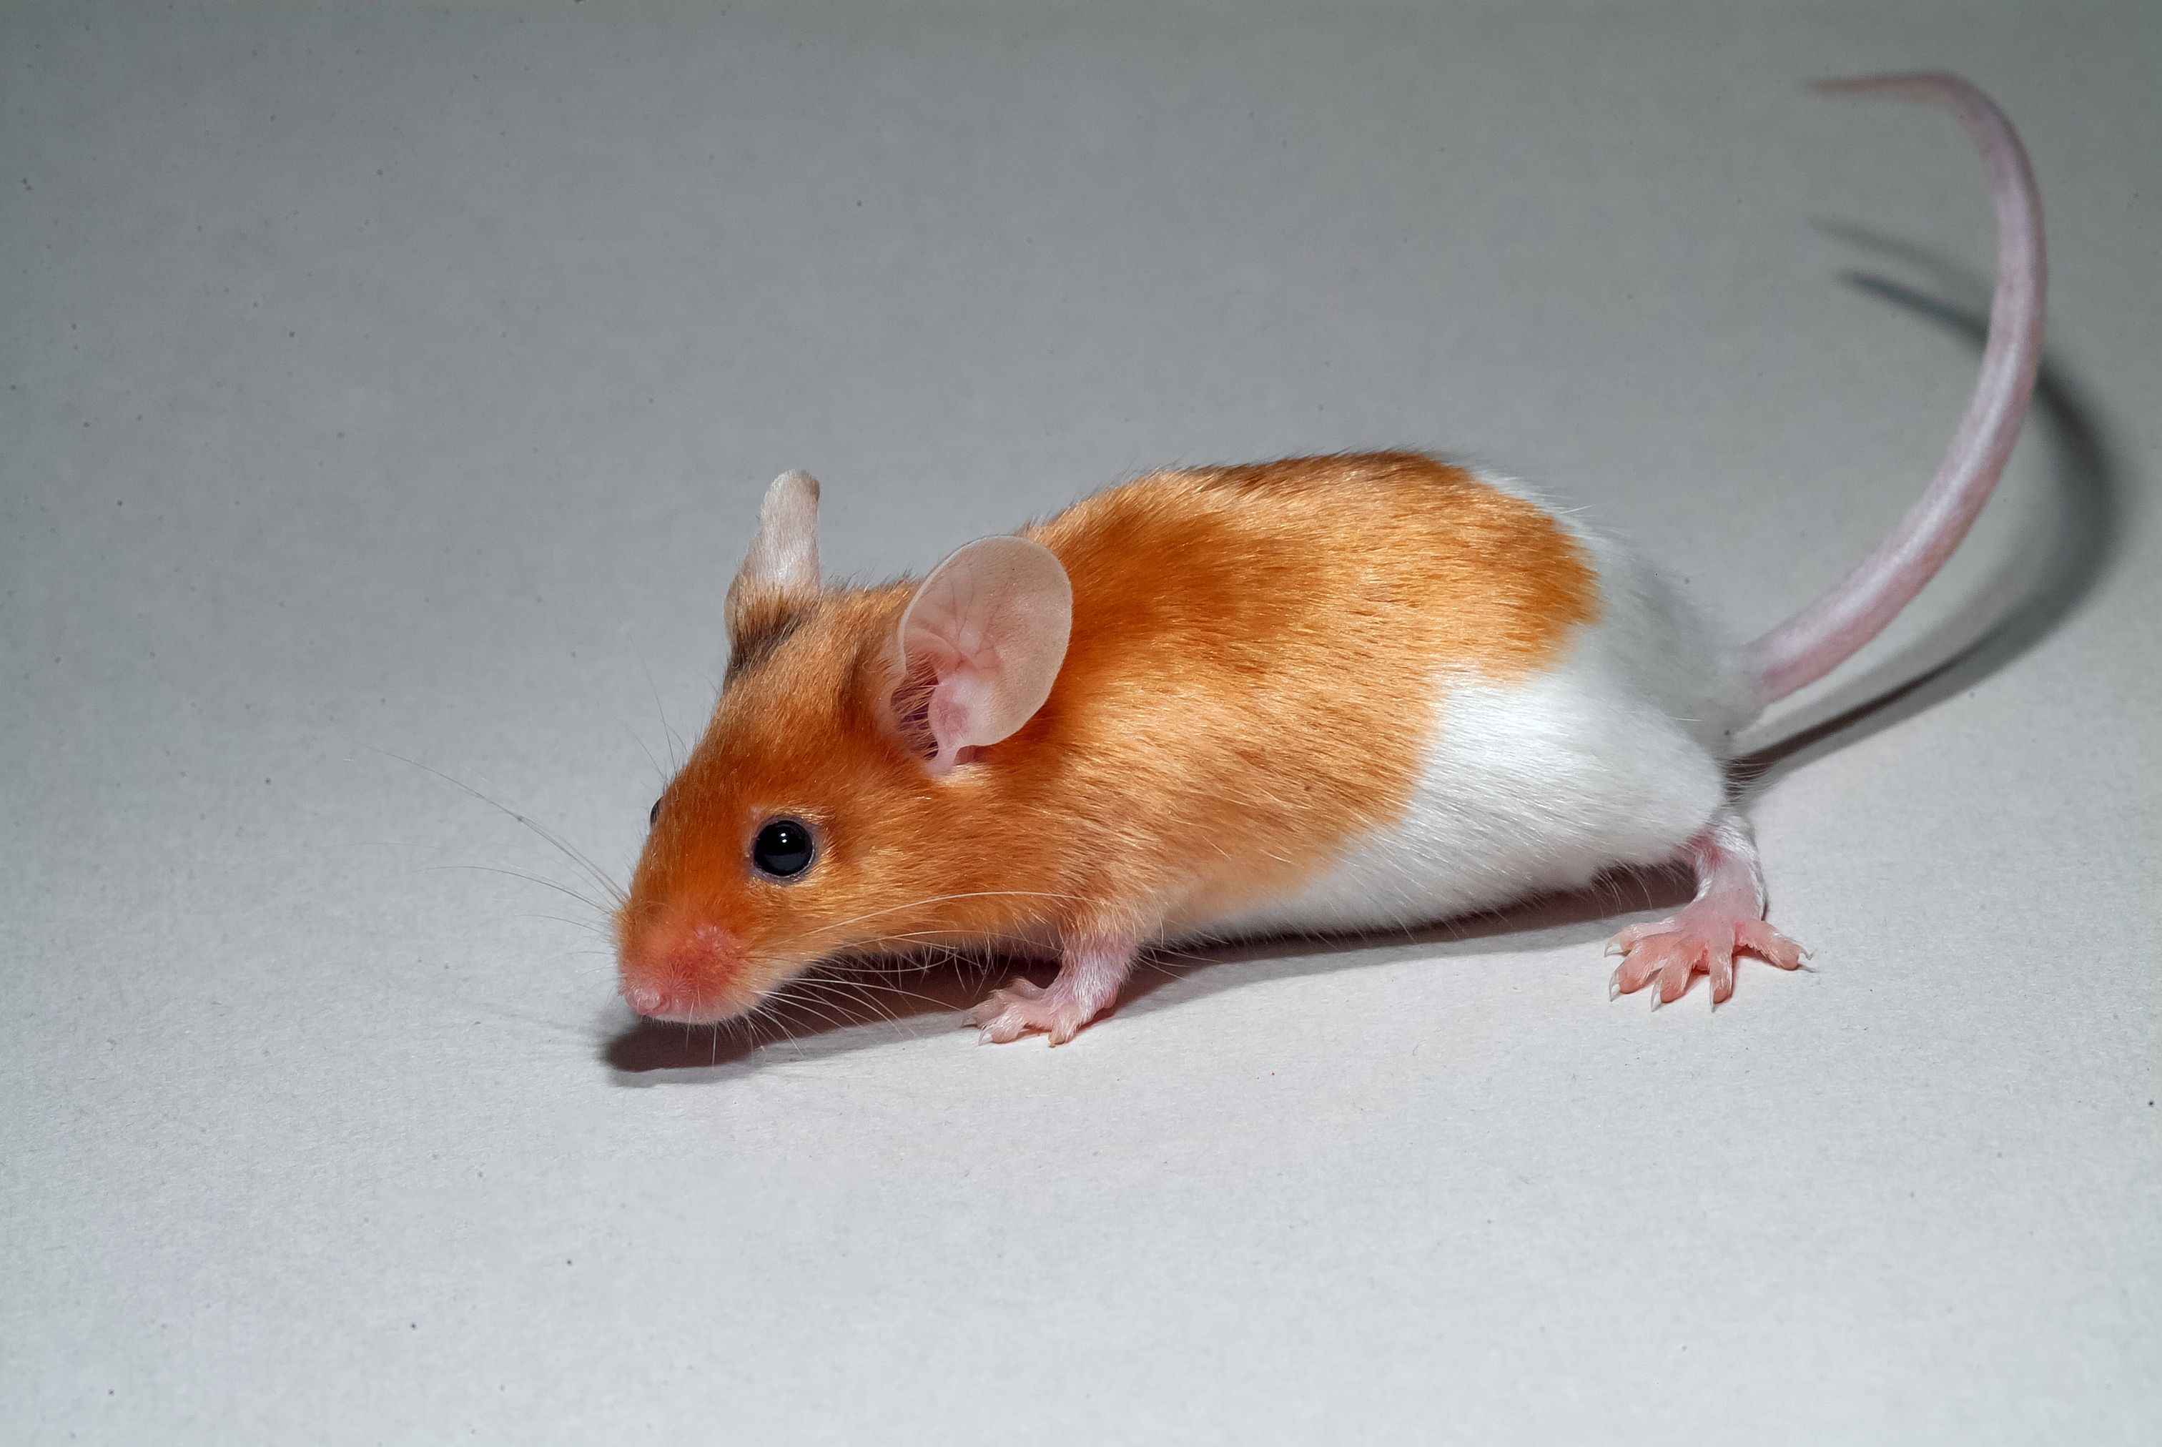


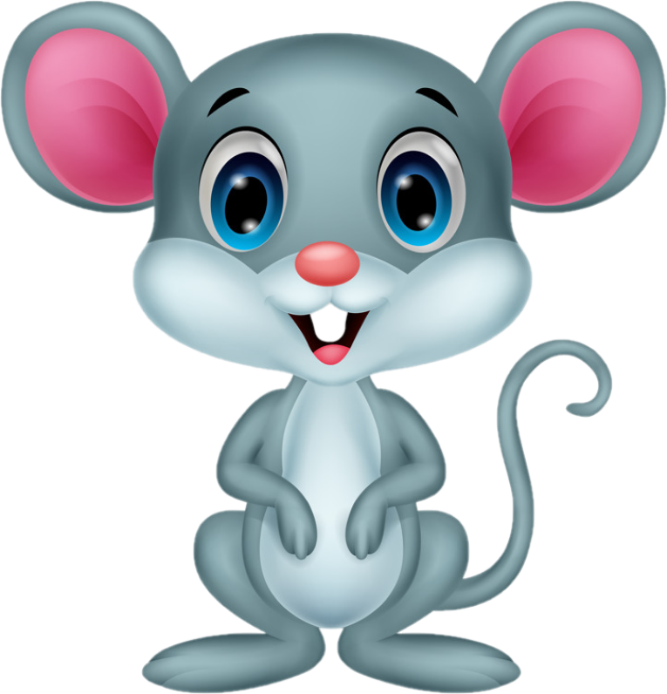
He froze, worried that if he moved one of them would snatch him up.
The mouse decided he had better be friendly with the cat, so he approached the cat, sat in front of him out of harm’s reach and said in a friendly tone, “How are you?”
Rami the cat replied, “I feel like anyone who is in a tight spot.”

Slide 6


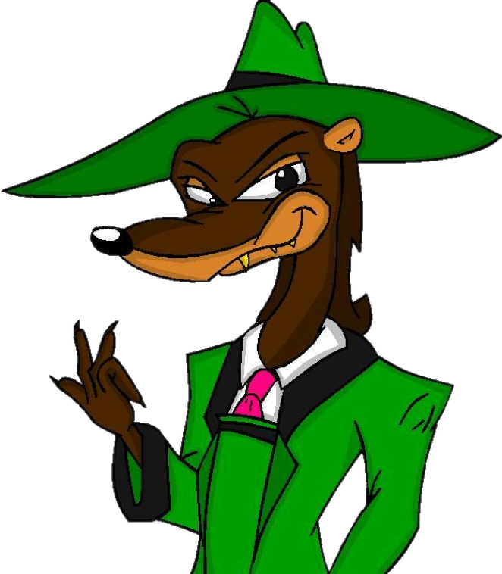
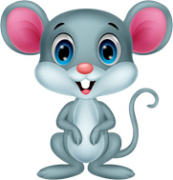
This seems like a fair deal. Yes I agree to protect you if you release me from this rope!
If you promise to protect me from the owl and the weasel, I will help set you free!
The mouse agreed to help set the cat free providing he protects the mouse in the future.

Slide 7

The mouse began to gnaw at the ropes with his sharp teeth, but the cat felt he was being rather slow and complained. The mouse had bitten through all the knots but one and he was wary of finishing the task in case the cat was tricking him.
Then they both noticed the hunter who had laid the snare, approaching across the glade.
At once Qaridun quickly finished cutting through the ropes, Rami ran up the tree and the mouse fled safely down his hole just in time.
The disappointed hunter left with the damaged ropes.

Slide 8

A few hours later the mouse peeped out of his hole and saw the cat in the distance.
The cat thought the mouse would be a tasty morsel and called out, “Come closer, I am your friend.”
Hey little buddy, you fancy some lunch?
Like I’m going to fall for that!

Slide 9
The cat’s persuasive tone did not convince the mouse, who explained to the cat that now they did not need each other, he felt that they were enemies once again, finally saying, “I’d rather not trust you now you no longer need me.” The mouse stayed away and safe.
DOH!
You don’t need me anymore, all you want to do is eat me! I think I’ll stay here!

Slide 10

This story, along with many other stories of this type, were used to teach morals to those who heard them.
This particular story was part of a series of stories that were used to teach Princes how to be wise!
They were written around 750AD and came from India and Persia and were told all over the middle east.
The tales are all told within the frame story of the King of India asking his chief philosopher Bidpai to make up fables for him.

Slide 11
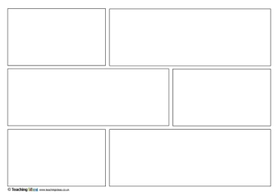
Can you create a cartoon strip for the story of the Cat and the Mouse?
You present this however you wish! You can use a template or a computer!

