Slide 1

Year 5 Computing
Searching on the Internet
- Lesson 3 -

Slide 2
Can you work out the anagrams to revise previous learning?
An anagram is a word or phrase formed by rearranging the letters of a different word or phrase, typically using all the original letters exactly once. For example, the word anagram can be rearranged into nag a ram, or the word binary into brainy or the word adobe into abode.

Slide 3
Can you guess the anagrams?
gehsarcin het nniertet
Searching the internet

Slide 4
Anagrams
ldwrwbiedoew
Worldwide Web

Slide 5
Anagrams
gahsceeernin
Search Engine

Slide 6
Anagrams
atannncdopfiio
Fact and Opinion

Slide 7
Complete the fact or opinion game
(next slide)

Slide 8
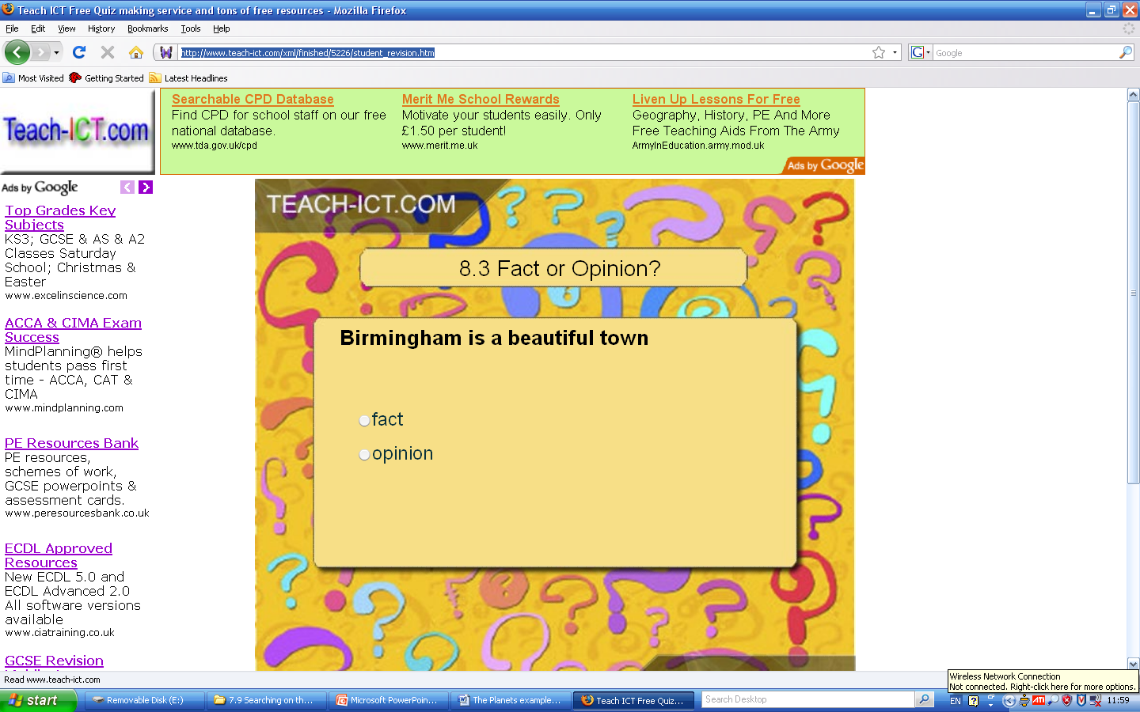
Notes:
http://www.teach-ict.com/xml/finished/5226/student_revision.htm

Slide 9
Objectives of the Lesson
Recap/learn validity and reliability when searching for information
Understand how to layout and present a report
Understand how to produce a report for assessment of ‘Searching on the Internet’

Slide 10
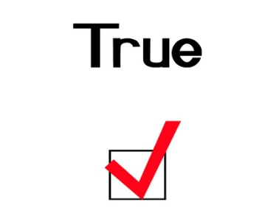
Information
Validity
Information that is true, up to date and accurate
Reliability
The quality of being dependable or trustworthy

Slide 11
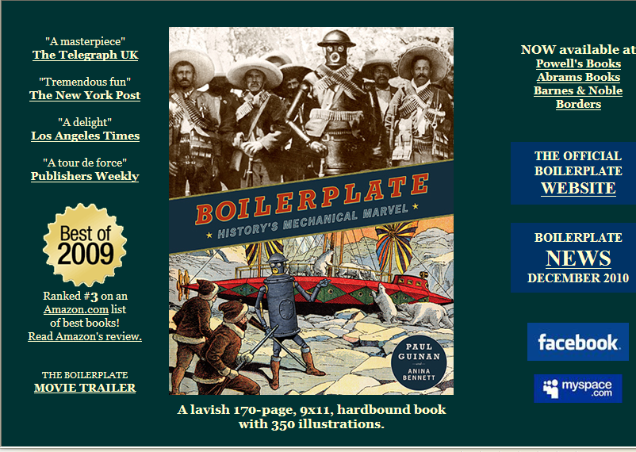
Validity | Information that is true, up to date and accurate | Check for dates Author About Us information
Reliability | The quality of being dependable or trustworthy | Domain name Internal/External Links

Slide 12
Objectives of the Lesson
Recap/learn validity and reliability when searching for information (Level 4/5)
Understand how to layout and present a report
Understand how to produce a report for assessment of ‘Searching on the Internet’

Slide 13
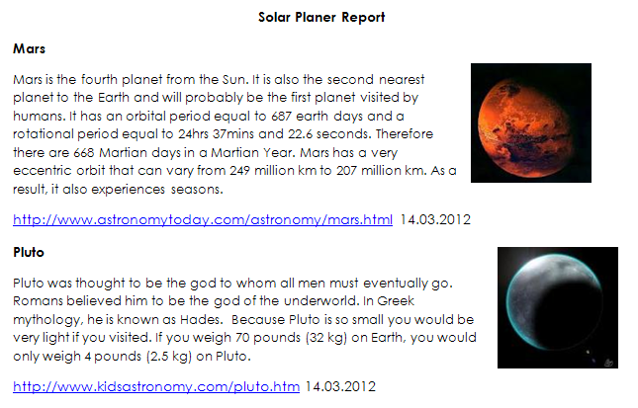
Report example - Solar Planet
Title
Name of Planet
Image of Planet
Information on Planet
Reference and Date
Silver task: Produce a researched, good quality document that has different types of information from many sources.
Gold task: Present your report in a well structured way that includes text and images and numbers. Information must be relevant and organised.

Slide 14
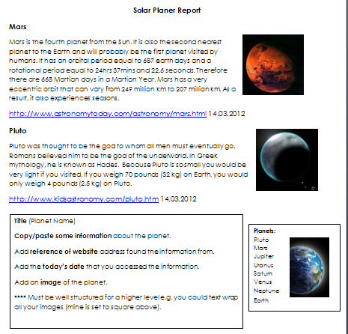
Title
Name of Planet
Information on Planet
Reference and Date
Silver task: Produce a researched, good quality document that has different types of information from many sources.
Gold task: Present your report in a well structured way that includes text and images and numbers. Information must be relevant and organised.

Slide 15
Task
Complete a similar report of 4-5 planets with:
Information from a website about the a planet
An image of a planet
Reference the website used
Silver task: Produce a researched, good quality document that has different types of information from many sources.
Gold task: Present your report in a well structured way that includes text and images and numbers. Information must be relevant and organised.
15 minutes

Slide 16
Objectives of the Lesson
Recap/learn validity and reliability when searching for information
Understand how to layout and present a report
Understand how to produce a report by Searching on the Internet

