Slide 1
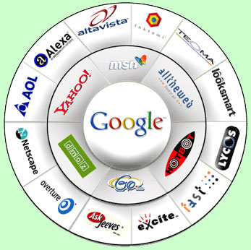
Year 5 Computing
Searching on the Internet
- Lesson 2 -

Slide 2
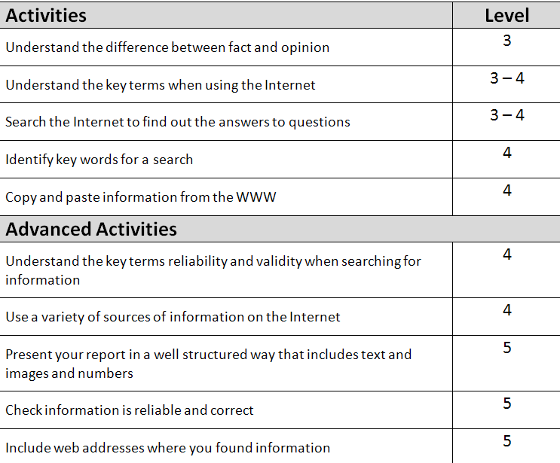

Slide 3
Objectives of the Lesson
Recap/understand the basic uses and keywords of the Internet
Learn and understand the difference between fact and opinion
To learn and understand the words:
Validity and Reliability of information
Aim: Be able identify a fact and opinion whilst being able to check if a website is valid and reliable.
Consider the new keywords when using websites:
Copyright, Validity, Reliability and Bias
Notes:
Understand website good/bad features left for homework instead of for the next main task as well.
This lesson discuss difference between fact and opinion but base next main task on the Blackpool searching task for level 4 – which is more relevant – update worksheet to suit class better and change dates so they are not out of date.

Slide 4


What are the new keywords?
What do they mean?
Internet | Computers connected to each other across the globe
WWW | World Wide Web
Email | Electronic Mail
Hypertext Mark-up Language | HTML
Search Engine | A system for searching the information available on the Web.
URL | Uniform Resource Locator

Slide 5

Common Features of a Webpage
Hyperlinks
HTML - Hypertext Markup Language
Navigation
Tags

Slide 6
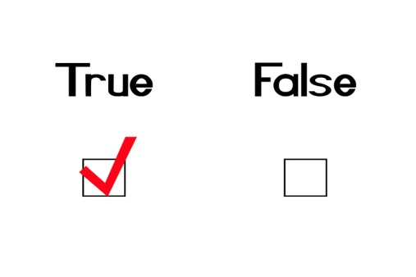
Information
Fact
A thing known to be true
Opinion
What someone thinks

Slide 7

Fact or Opinion?
The Earth is round
I like computing!

Slide 8
Fact or Opinion?
I think Maths is fun
April comes after March

Slide 9
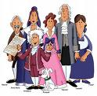
Fact or opinion?
I think that classical music is boring.

Slide 10
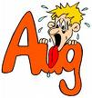
Fact or Opinion?
August follows July every year.

Slide 11
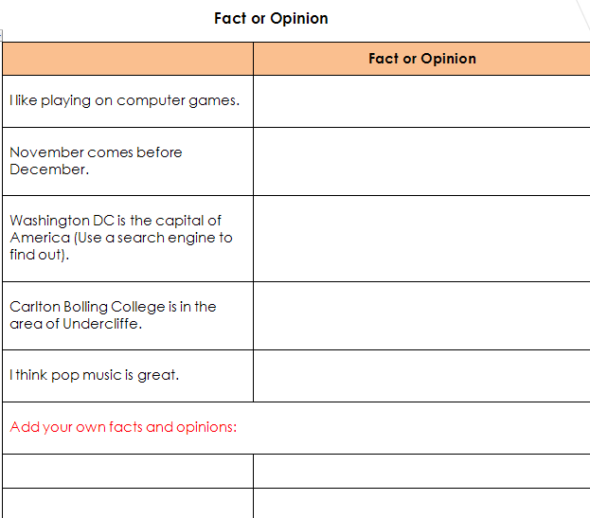
Complete the Fact and Opinion Task
Complete the fact and opinion worksheet.

Slide 12
Objectives of the Lesson
Recap/understand the basic uses and keywords of the Internet
Learn and understand the difference between fact and opinion
To learn and understand the words:
Validity and Reliability of information
Aim: Be able identify a fact and opinion whilst being able to check if a website is valid and reliable.
Consider the new keywords when using websites:
Copyright, Validity, Reliability and Bias
Notes:
Understand website good/bad features left for homework instead of for the next main task as well.
This lesson discuss difference between fact and opinion but base next main task on the Blackpool searching task for level 4 – which is more relevant – update worksheet to suit class better and change dates so they are not out of date.

Slide 13

Information
Validity
Information that is true, up to date and accurate
Reliability
The quality of being dependable or trustworthy

Slide 14
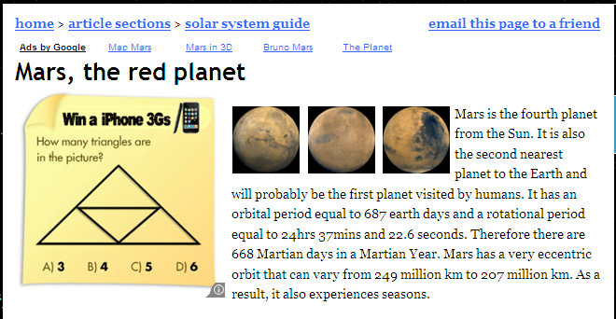
Validity | Information that is true, up to date and accurate | Check for dates Author About Us information
Reliability | The quality of being dependable or trustworthy | Domain name Internal/External Links

Slide 15
Read the information find some facts and opinions.
Comment on the validity and reliability of the websites.
Information Task
Check out the following website:
http://www.astronomytoday.com/astronomy/mars.html

Slide 16
Fact |  | What someone thinks
Reliability |  | A thing known to be true
Opinion |  | A system for searching the information available on the Web
Validity |  | Information that is true, up to date and accurate
Search Engine |  | Uniform Resource Locator
URL |  | The quality of being dependable or trustworthy

Slide 17
Objectives of the Lesson
Recap/understand the basic uses and keywords of the Internet
Learn and understand the difference between fact and opinion
To learn and understand the words:
Validity and Reliability of information
Aim: Be able identify a fact and opinion whilst being able to check if a website is valid and reliable.
Consider the new keywords when using websites:
Copyright, Validity, Reliability and Bias
Notes:
Understand website good/bad features left for homework instead of for the next main task as well.
This lesson discuss difference between fact and opinion but base next main task on the Blackpool searching task for level 4 – which is more relevant – update worksheet to suit class better and change dates so they are not out of date.

Slide 18
Your task
Complete Lesson 2 sheet called:
Information: Fact, Opinion,
Reliability & Validity

