Slide 1
Computing – Searching the Internet
You will need to be able to:
Search for information effectively
Visit specific sites and extract information to answer questions
Write/provide evidence of your findings
create a report based on topic chosen
Internet and Microsoft Word

Slide 2
Objectives of the Lesson
Learn/understand the basic keywords and uses of the Internet
Understand the different ways we use the internet
Understand how to search the Internet to find out the answers to questions
Key words: Internet, search engine, www, URL

Slide 3

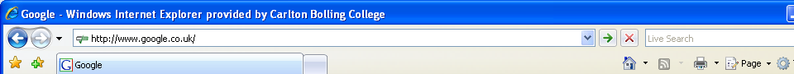
The Internet
Internet
Computers connected to each other across the globe
WWW
World Wide Web
E-MAIL
Electronic Mail
HTML
HyperText Mark-up Language
  A system for searching the information available on the Web.
SEARCH
ENGINE
URL
Uniform Resource Locator

Slide 4
Objectives of the Lesson
Learn/understand the basic keywords and uses of the Internet
Understand the different ways we use the internet
Understand how to search the Internet to find out the answers to questions
Key words: Internet, search engine, www, URL

Slide 5



What do we use the Internet for?

Slide 6
Objectives of the Lesson
Learn/understand the basic keywords and uses of the Internet
Understand the different ways we use the internet
Understand how to search the Internet to find out the answers to questions
Key words: Internet, search engine, www, URL

Slide 7
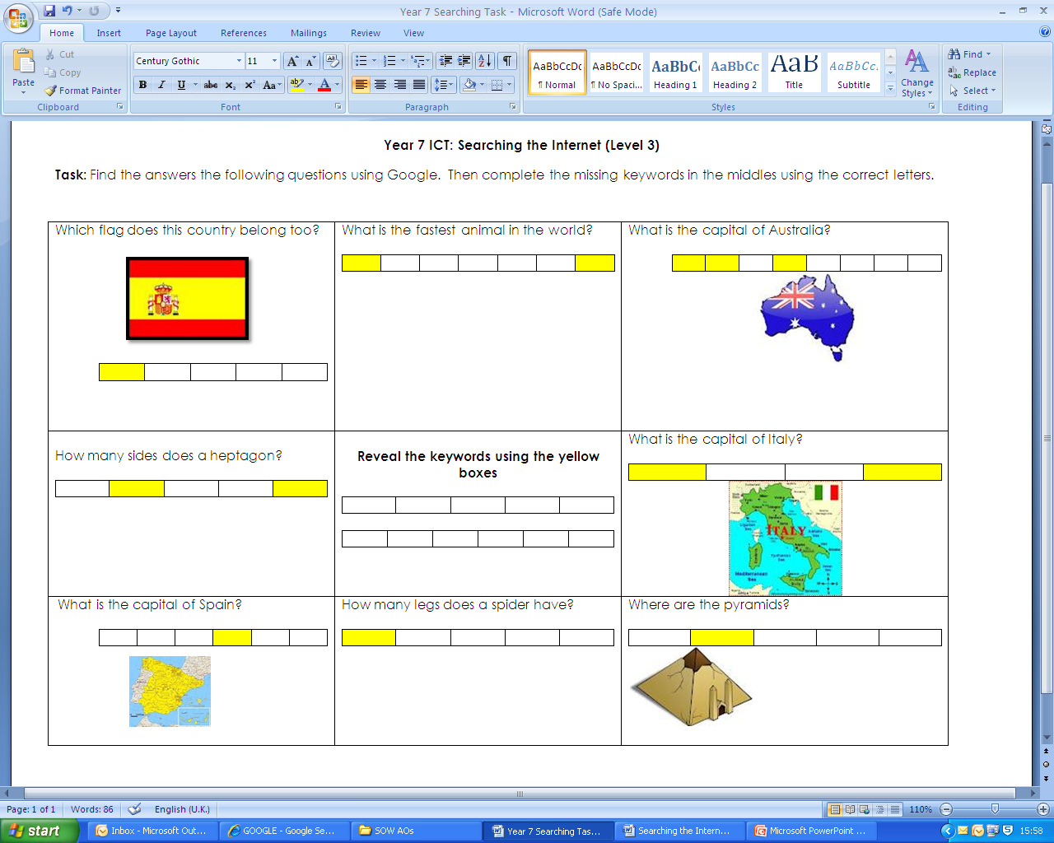
Searching Task (Level 3-4)
Notes:
Students to work through search worksheets can also use as extension task for throughout this topic...

Slide 8
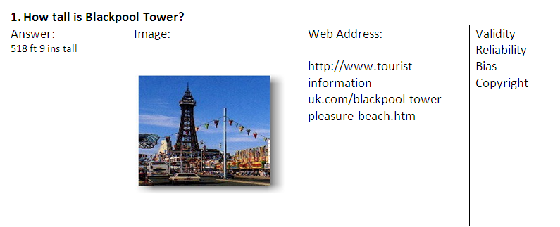
Searching Task 2
Task: Complete ALL searches. Find out every answer to ALL questions using a search engine.
Notes:
Students to work through search worksheets can also use as extension task for throughout this topic...

Slide 9
Objectives of the Lesson
Learn/understand the basic keywords and uses of the Internet
Understand the different ways we use the internet
Understand how to search the Internet to find out the answers to questions
Key words: Internet, search engine, www, URL

