Slide 1




Year 5 – Summer - Block 1
Decimals

Slide 2




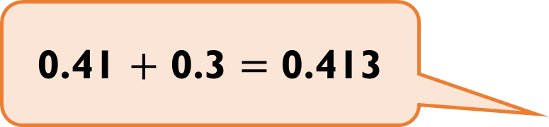
What mistake has Dora made?
Use at least 2 representations to show why she is incorrect.
0.41 $+$ 0.3 $=$ 0.413

Slide 3
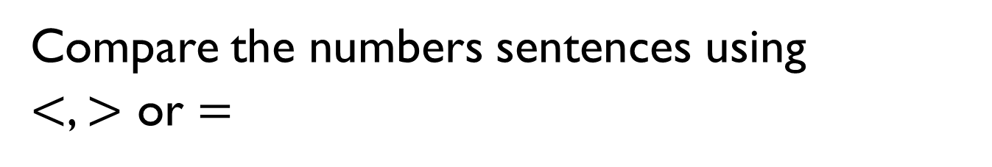
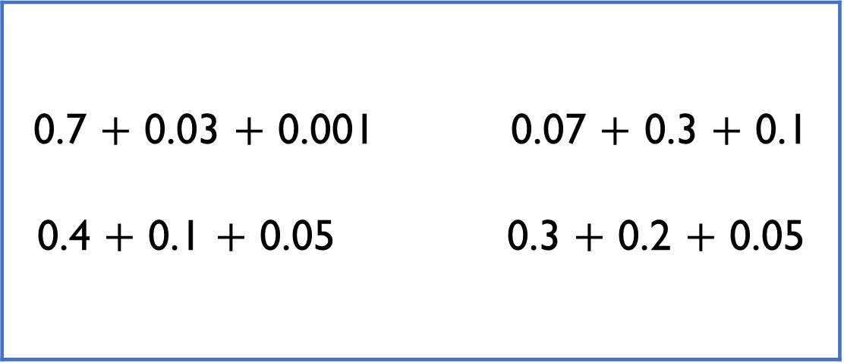
Compare the numbers sentences using
$<$, $>$ or $=$
0.7 $+$ 0.03 $+$ 0.001 0.07 $+$ 0.3 $+$ 0.1 0.4 $+$ 0.1 $+$ 0.05 0.3 $+$ 0.2 $+$ 0.05

Slide 4

Rosie has some digit cards.
She uses each card once to make a number sentence.
What is the largest number she can make? What is the smallest?
0
1
2
3
4
5
0
0
$$+$$

Slide 5
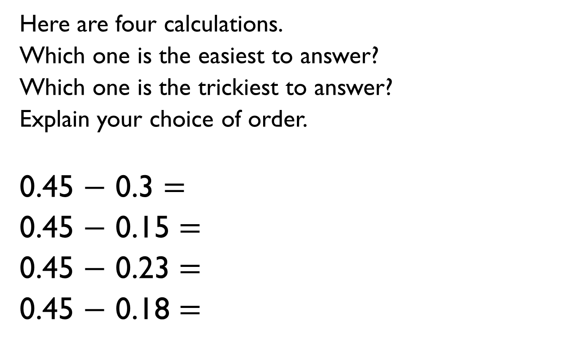
Here are four calculations.
Which one is the easiest to answer?
Which one is the trickiest to answer?
Explain your choice of order.
0.45 $−$ 0.3 $=$
0.45 $−$ 0.15 $=$
0.45 $−$ 0.23 $=$
0.45 $−$ 0.18 $=$

Slide 6
0.8
The strip of paper is 0.8 m long.
It is cut into two unequal parts.
The difference in lengths between the two strips of paper is 0.1 m
How long are the two strips of paper?
0.8
0.1

Slide 7

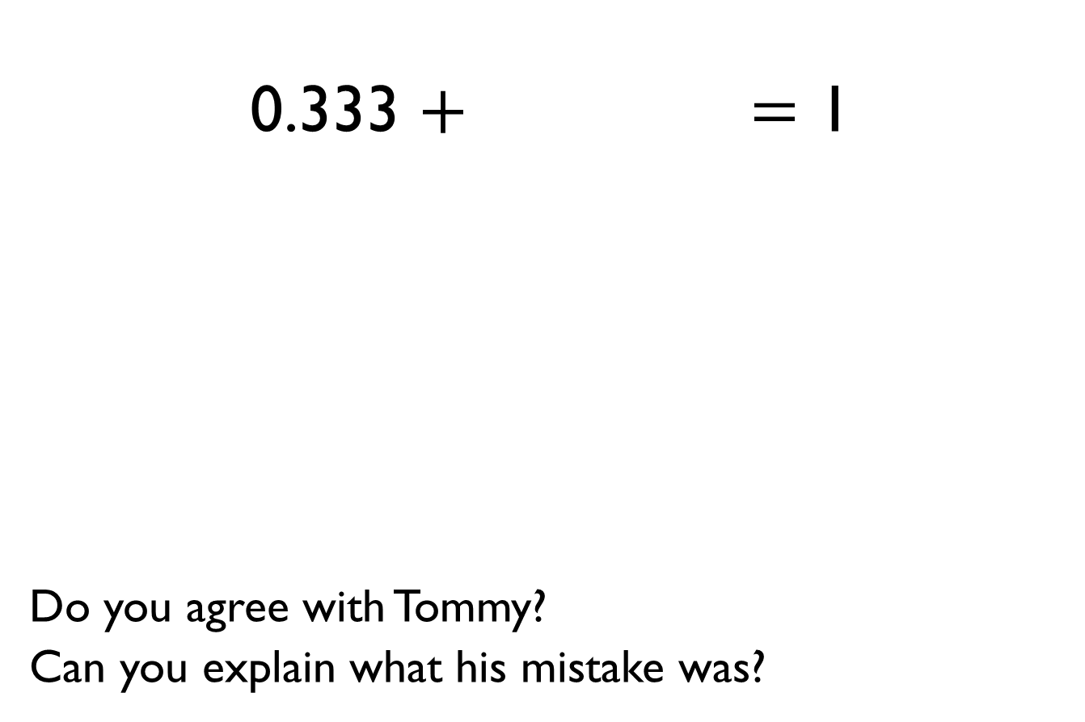
0.333 $+$ $=$ 1
Do you agree with Tommy?
Can you explain what his mistake was?
I think the answer is 0.777
because
0.3 + 0.7 = 1
0.03 + 0.07 = 0.1
0.003 + 0.007 = 0.01

Slide 8
How many different ways can you find a path through the maze, adding each number at a time, to make a total of one?
Once you have found a way, can you design your own smaller maze for others to solve?
Start
0.02 | 0.01 | 0.05 | 0.08 | 0.3 | 0.04 | 0 | 0.001
0.2 | 0.06 | 0.07 | 0.09 | 0.001 | 0.004 | 0.02 | 0.04
0.005 | 0.04 | 0.2 | 0.02 | 0.05 | 0.06 | 0.07 | 0.6
0.5 | 0.005 | 0.05 | 0.02 | 0.03 | 0.017 | 0.006 | 0.06
0.009 | 0.8 | 0.001 | 0.05 | 0.015 | 0.01 | 0.008 | 0.007
0.09 | 0.2 | 0.08 | 0.03 | 0.199 | 0.01 | 0.04 | 0.05
0.01 | 0.008 | 0.1 | 0.09 | 0.005 | 0.08 | 0.02 | 0.02
0.05 | 0.03 | 0.01 | 0.22 | 0.07 | 0.003 | 0.04 | 0.09
1

Slide 9
A place value grid is used to solve 0.7 + 0.5
Alex thinks the answer is 0.12
What mistake has she made?
Ones | Tenths

Slide 10
You will need a partner and a dice for this game.
Take it in turns rolling the dice and place the digits in the blank spaces above. Record the number in a table.
Swap over with your partner.
Roll the dice again and add your new number to the first number. The winner is the person who after adding 4 numbers is the closest to 1.5 without going over.
0

Slide 11
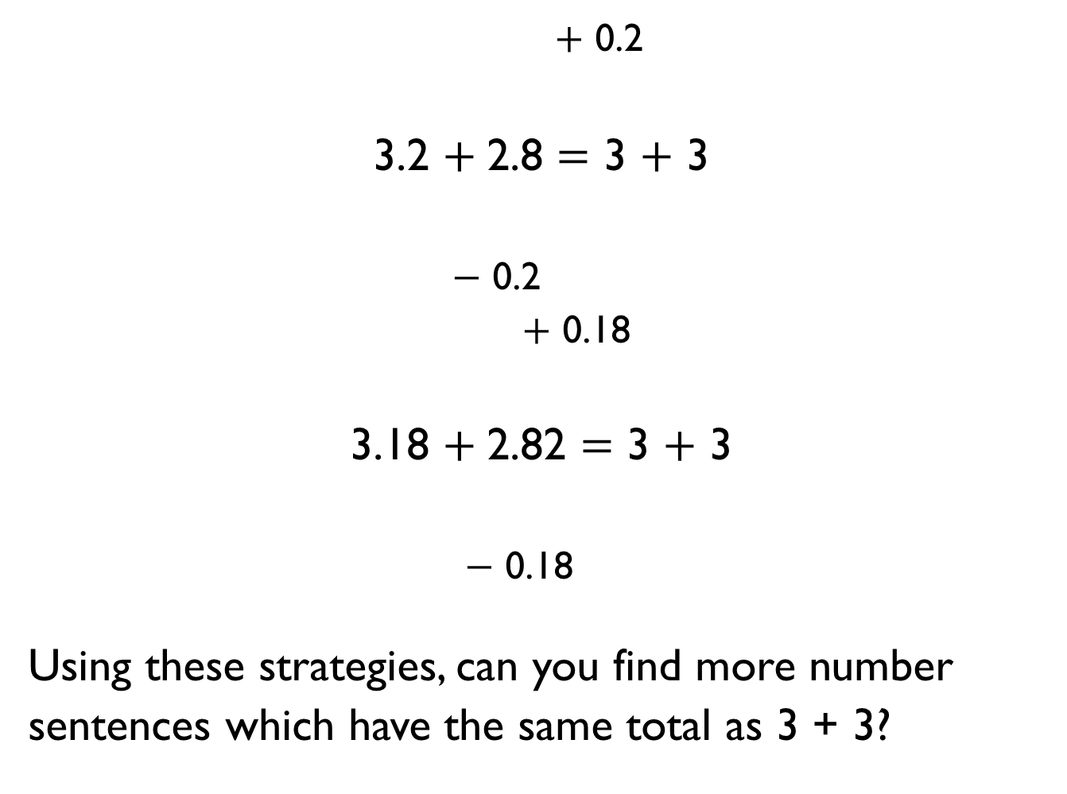
$+$ 0.2
3.2 $+$2.8 $=$ 3 $+$ 3
$−$ 0.2
$+$ 0.18
3.18 $+$2.82 $=$ 3 $+$ 3
$−$ 0.18
Using these strategies, can you find more number sentences which have the same total as 3 + 3?

Slide 12
Using the digits 0 – 9 only once in each of the spaces above, what is:
The largest sum possible
The smallest sum possible
Is there more than one way of creating each total?
+

Slide 13
Dexter and Annie have some money.
Dexter has £3.45 more than Annie.
They have £12.45 altogether.
How much money does Annie have?
Dexter
Annie

Slide 14
In this number pyramid, each number is calculated by adding the two numbers underneath.
11.32
 | 3.25
5.94 | 2.13
 | 1.06 |  | 0.05

Slide 15

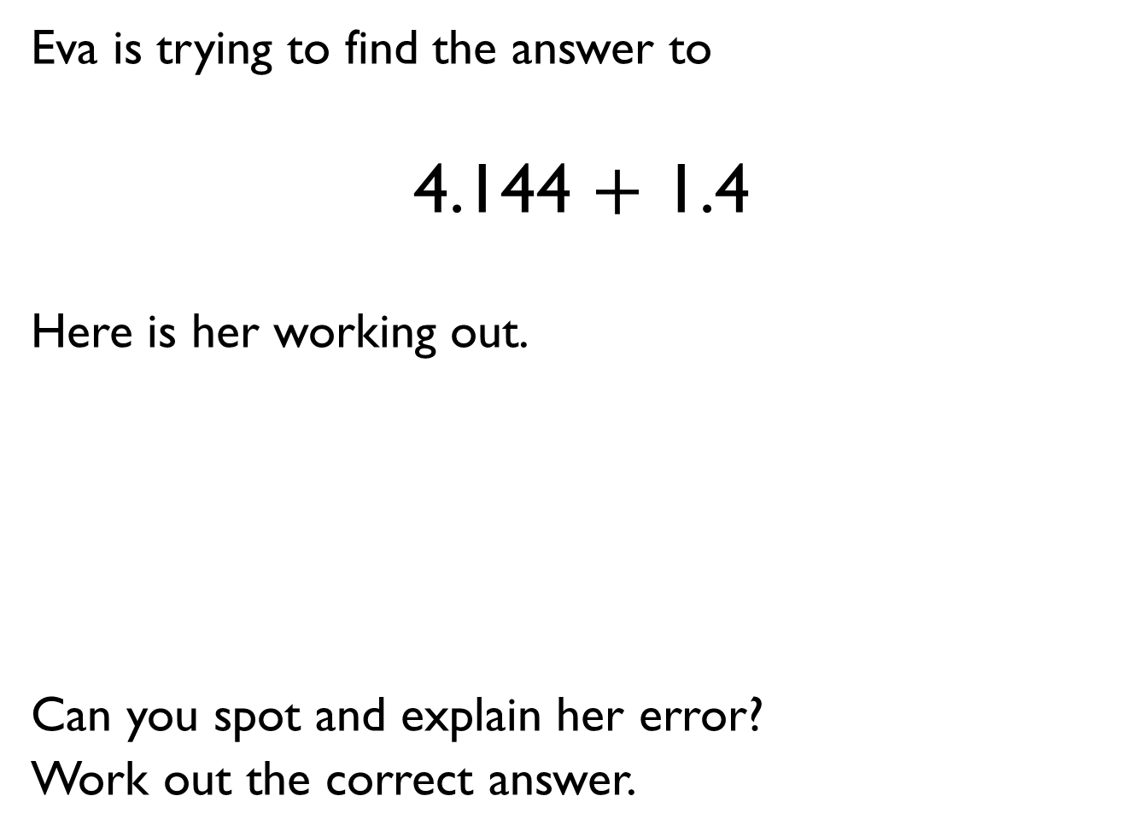

Eva is trying to find the answer to
4.144 $+$ 1.4
Here is her working out.
Can you spot and explain her error?
Work out the correct answer.
4 | . | 1 | 4 | 4
 |  | 1 | . | 4
4 | . | 2 | 4 | 8
$$+$$

Slide 16
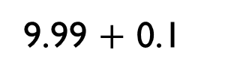
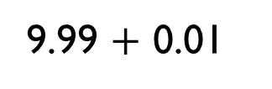
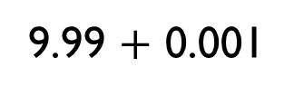
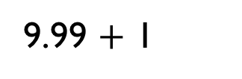
Place the calculations in the correct column in the table.
Some calculations might need to go in more than one place.
Add 2 more calculations to each column.
9.99 $+$ 0.1
9.99 $+$ 1
9.99 $+$ 0.001
9.99 $+$ 0.01
No exchange | Exchange in ones column | Exchange in tenths column | Exchange in hundredths column | Exchange in thousandths column

Slide 17

Do you agree with Whitney?
Explain your answer.
If there are 5 hundredths and I subtract nothing from it then there are still 5 hundredths.
4 | . | 9
3 | . | 8 | 5
1 | . | 1 | 5

Slide 18
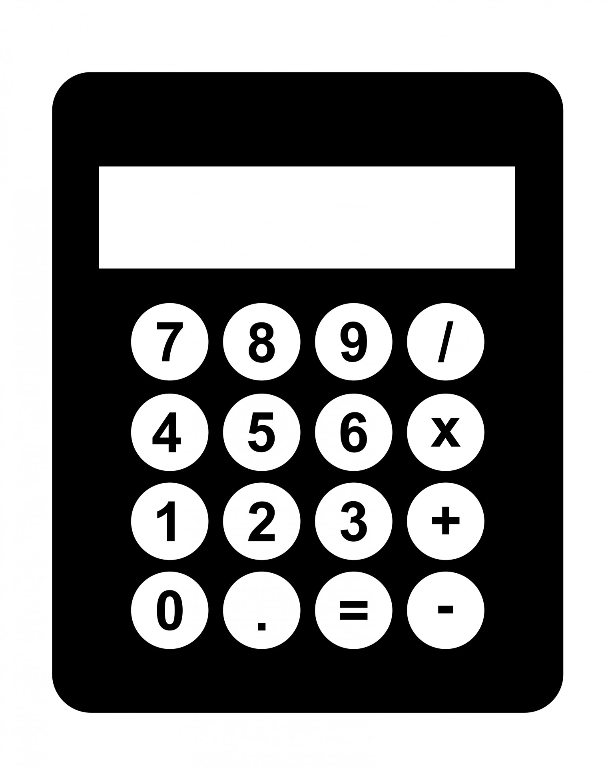
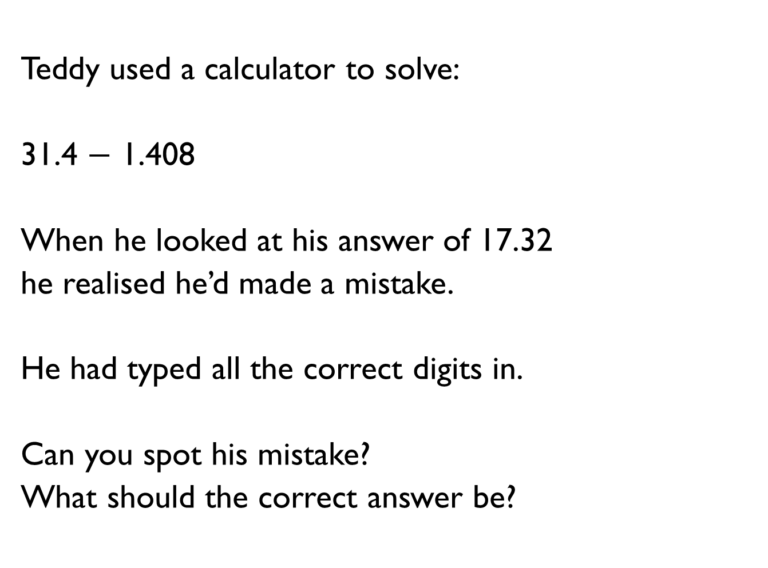
Teddy used a calculator to solve:
31.4 $−$ 1.408
When he looked at his answer of 17.32
he realised he’d made a mistake.
He had typed all the correct digits in.
Can you spot his mistake?
What should the correct answer be?
17.32

Slide 19
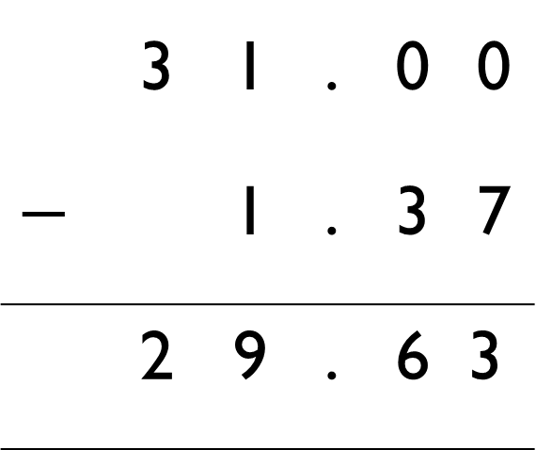
What are the missing digits in the calculation?
 | 3 | 1 | . | 0 | 0
$$−$$ |  | 1 | . | 3 | 7
 | 2 | 9 | . | 6 | 3

Slide 20

Two envelopes contain two different numbers.
The sum of the numbers is 9.92
The difference between the numbers is 2.32
What numbers are inside the envelopes?
How can this bar model help?
A
B
9.92

Slide 21

9.48 9.52 9.56 9.6 …
Do you agree with Jack?
Explain your answer.
The number 9.7 will be in this sequence.

Slide 22


 | 1st sequence | Relationship | 2nd sequence
1st term | 0.1 |  | 1
2nd term | 0.2 |  | 2
3rd term | 0.3 |  | 3
4th term | 0.4 |  | 4
5th term
Eva compared the two sequences above. What do you notice about the differences between the terms in the two sequences?
Investigate Eva’s sequences below and explain your thinking.
I wonder what the differences would be between sequences that go up in $+$ 0.01 and $+$1 sequence…

Slide 23

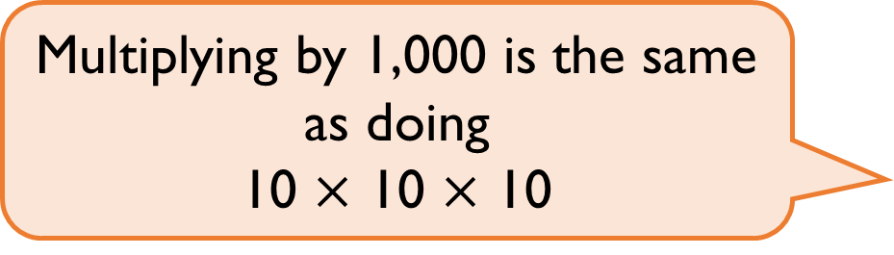
Do you agree with Mo?
Explain your answer
Multiplying by 1,000 is the same as doing
10 $×$ 10 $×$ 10

Slide 24
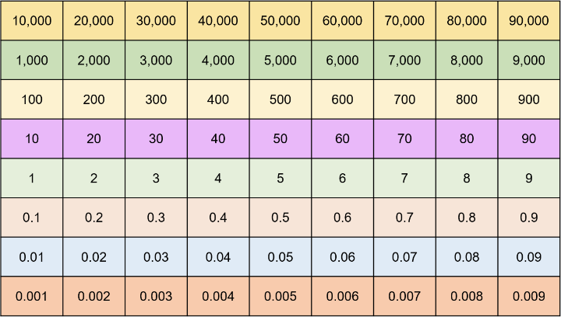
Using the digits 0-9 create a number with up to 3 decimal places, for example, 3.451
Cover the number using counters on your Gattegno chart.
Explore what happens when you multiply your number by 10, then 100, then 1,000
What patterns do you notice?

Slide 25


Who do you agree with?
Explain your thinking
If you multiply a number by 1,000, you can just divide the answer by 1,000 to get back to your original number.
That’s not true, you would need to divide the answer by ten three times.

Slide 26

Here are three rectangles.
The lengths of rectangle B are 10 times larger than rectangle A.
The lengths of rectangle C are 100 times smaller than rectangle B.
Do you agree with Mo?
Explain your thinking.
2.4m
B
0.7m
A
C
The perimeter of rectangle A is 1,000 times greater than rectangle C’s.

