Slide 1




Year 5 - Spring - Block 3
Decimals & Percentages

Slide 2




Dexter says there is only one way to partition 0.62
Prove Dexter is incorrect by finding at least three different ways of partitioning 0.62
0.62
0.6
0.02

Slide 3




Match each description to the correct number.
Teddy
Amir
Rosie
Eva
My number has the same amount of tens and tenths.
My number has one decimal place.
My number has two hundredths.
My number has six tenths.
46.2
2.64
46.02
40.46

Slide 4
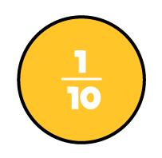
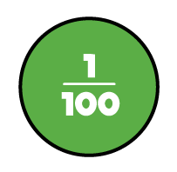


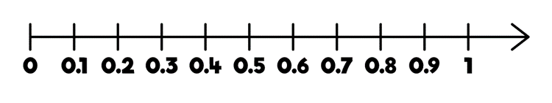
Odd one out
Which of the images below is the odd one out?
Explain why.
A
B
C
D

Slide 5
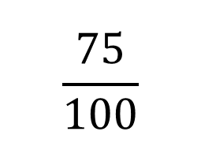
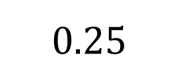
How many different ways can you complete the part-whole model using fractions and decimals?
Create another part-whole model like the one above for your partner to complete.
$$\frac{75}{100}$$
$$0.25$$

Slide 6
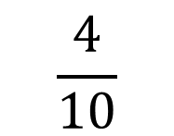

Now complete the following part-whole models using fractions and decimals.
$$0.75$$
$$\frac{4}{10}$$

Slide 7
2.25 = 2 ones, 2 tenths and 5 hundredths.
Can you write the following numbers in at least three different ways?
23.7 2.37 9.08 0.98

Slide 8
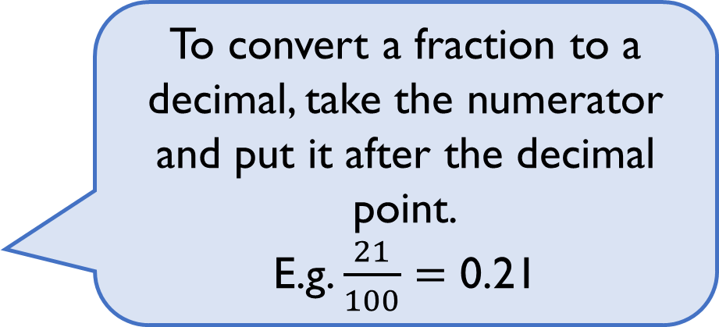
Amir says,
Write two examples of converting fractions to decimals to prove this does not always work.
To convert a fraction to a decimal, take the numerator and put it after the decimal point.
E.g. $\frac{21}{100}$ $=$ 0.21

Slide 9
Use the digits 3, 4 and 5 to complete the decimal number.
List all the possible numbers you can make.
Write these decimals as mixed numbers.
Choose three of the numbers and write them in words.
3
0
.
4
5

Slide 10



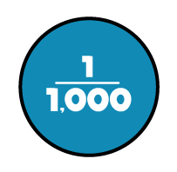

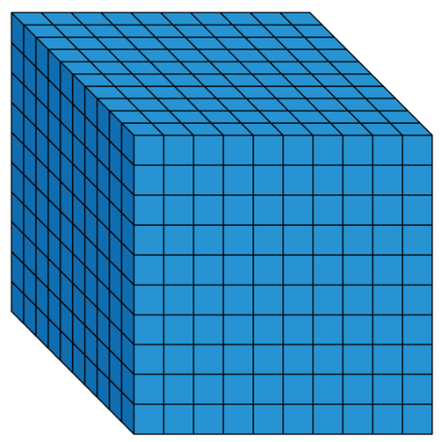
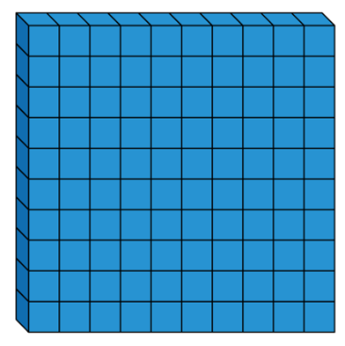


Rosie thinks the 2 values are equal.
Do you agree?
Explain your thinking.
Can you write this amount as a decimal and as a fraction?
=

Slide 11
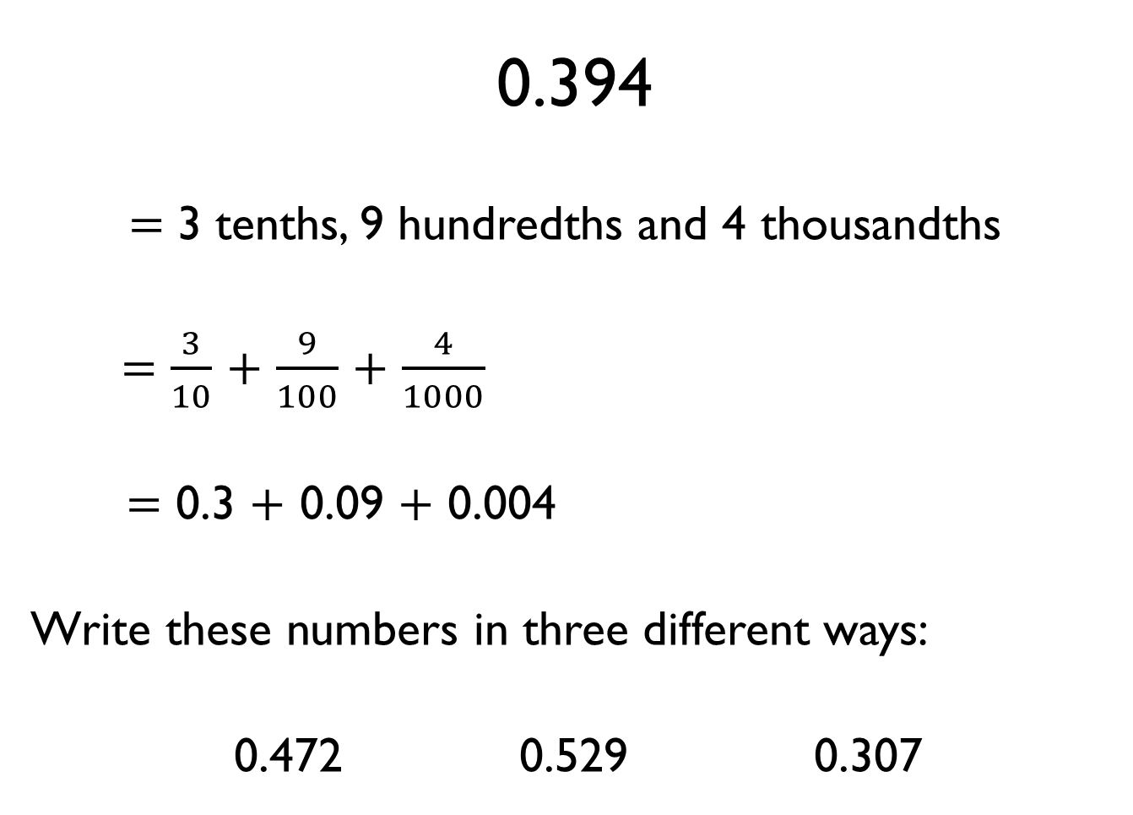
0.394
$=$ 3 tenths, 9 hundredths and 4 thousandths
$=$ $\frac{3}{10}$ $+$ $\frac{9}{100}$ $+$ $\frac{4}{1000}$
$=$ 0.3 $+$ 0.09 $+$ 0.004
Write these numbers in three different ways:
0.472 0.529 0.307

Slide 12
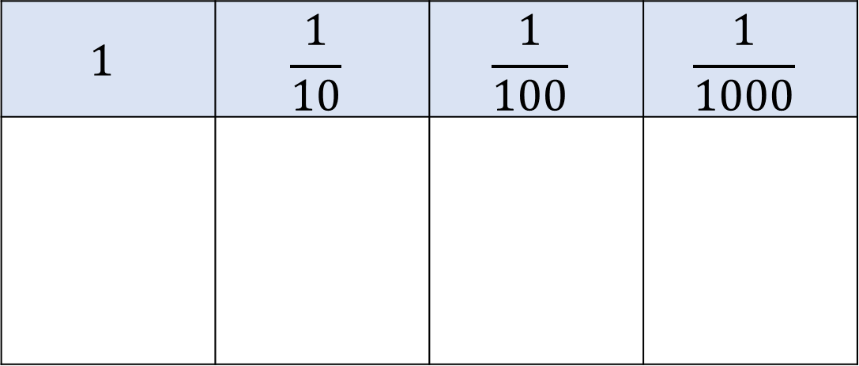
Ron has 8 counters. He makes numbers using the place value chart.
At least 3 columns have counters in.
What is the largest and the smallest number he can make with 8 counters?
Can you record the numbers in different ways?
$$1$$ | $$\frac{1}{10}$$ | $$\frac{1}{100}$$ | $$\frac{1}{1000}$$

Slide 13
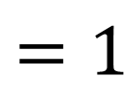
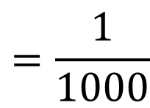
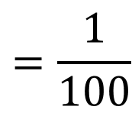
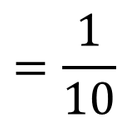
In this problem symbols have been used to represent two different numbers.
Write down the value of each, as a mixed number and as a decimal.
$$=1$$
$$=\frac{1}{10}$$
$$=\frac{1}{100}$$
$$=\frac{1}{1000}$$

Slide 14


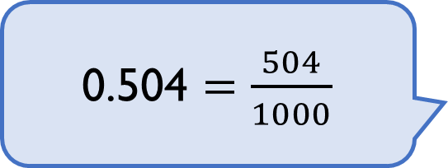
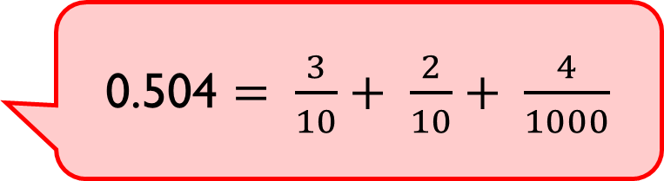
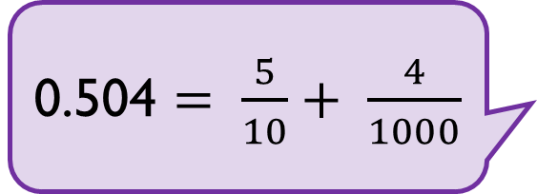
Three children are representing the number 0.504
Annie
Alex
Teddy
Who is correct?
Explain why.
0.504 $=\frac{504}{1000}$
0.504 $= \frac{3}{10}+ \frac{2}{10}+ \frac{4}{1000}$
0.504 $= \frac{5}{10}+ \frac{4}{1000}$

Slide 15

Dexter is measuring a box
of chocolates with a ruler
that measures in
centimetres and millimetres.
He measures it to the nearest cm and writes the answer 28 cm.
What is the smallest length the box of chocolates could be?

Slide 16

Whitney is thinking of a number.
Rounded to the nearest whole her number is 4
Rounded to the nearest tenth her number is 3.8
Write down at least 4 different numbers that she could be thinking of.

Slide 17
A number between 11 and 20 with 2 decimal places rounds to the same number when rounded to one decimal place and when rounded to the nearest whole number.
What could this be?
Is there more than one option?
Explain why.

Slide 18


Alex says,
Do you agree?
Explain your answer.
3.105 is greater than 3.2 because 105 is greater than 2

Slide 19

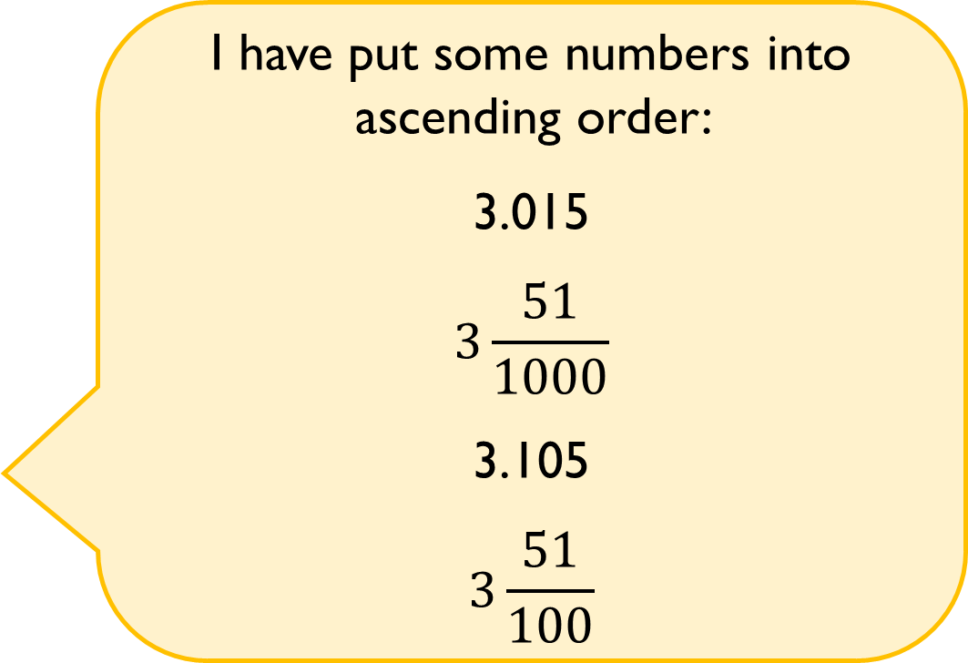
I have put some numbers into ascending order:
3.015
$$3\frac{51}{1000}$$
3.105
$$3\frac{51}{100}$$
Tommy says,
Tommy has missed one number out.
It should go in the middle of this list.
What could his number be?
What can’t his number be?

Slide 20
Oh no! Dexter has spilt ink on his hundred square.
Complete the sentence stems to describe what percentage is shaded.
It could be…
It must be…
It can’t be…

Slide 21
Mo, Annie and Tommy all did a test with 100 questions. Tommy got 6 fewer questions correct than Mo.
Complete the table.
How many more marks did each child need to score 100%?
100%
Name | Score | Percentage
Mo | 56 out of 100
Annie |  | 65%
Tommy
30%

Slide 22
Dora and Amir each have 100 sweets.
Dora eats 65% of hers.
Amir has 35 sweets left.
Who has more sweets left?

Slide 23

Teddy says,
Is Teddy correct? Explain your answer.
To convert a fraction to a percentage, you just need to put a percent sign next to the numerator.

Slide 24
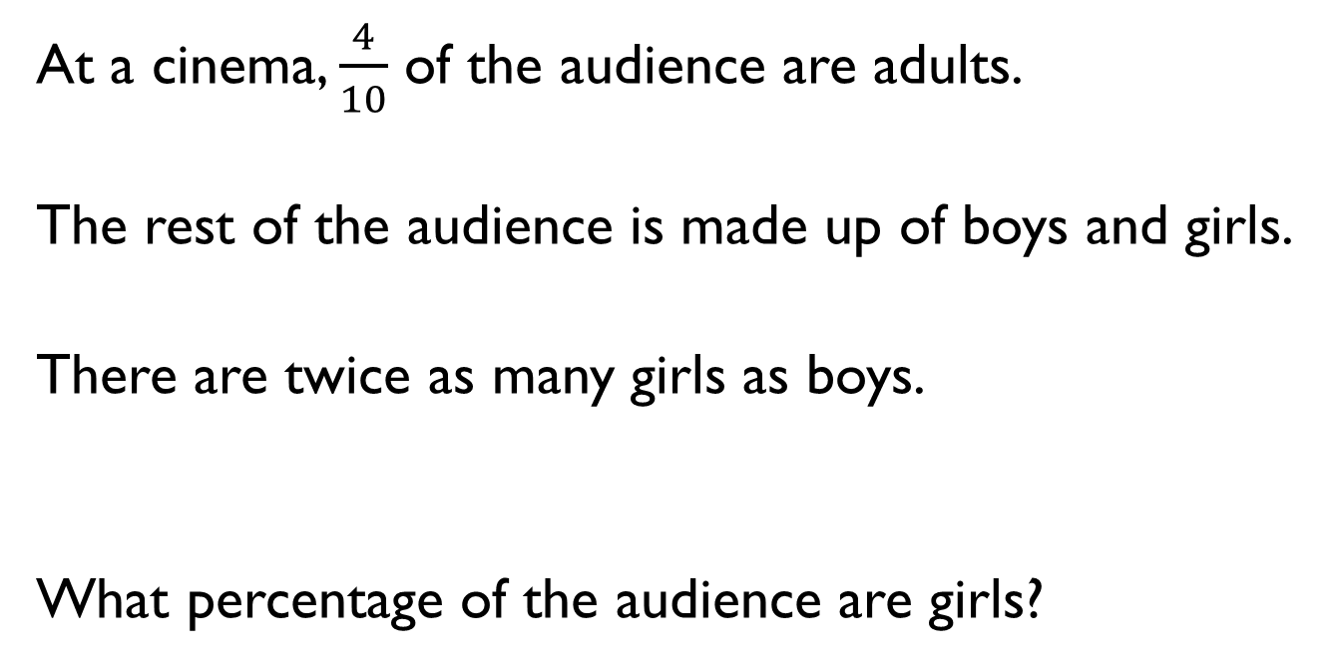
At a cinema, $\frac{4}{10}$ of the audience are adults.
The rest of the audience is made up of boys and girls.
There are twice as many girls as boys.
What percentage of the audience are girls?

Slide 25
Three children have each read 360 pages of their own book.
Ron’s book has 500 pages.
Dora’s book has 400 pages.
Eva’s book has 600 pages.
What fraction of their books have they each read?
What percentage of their books have they read?
How much of their books have they each read as a decimal?
Who has read the most of their book?

Slide 26
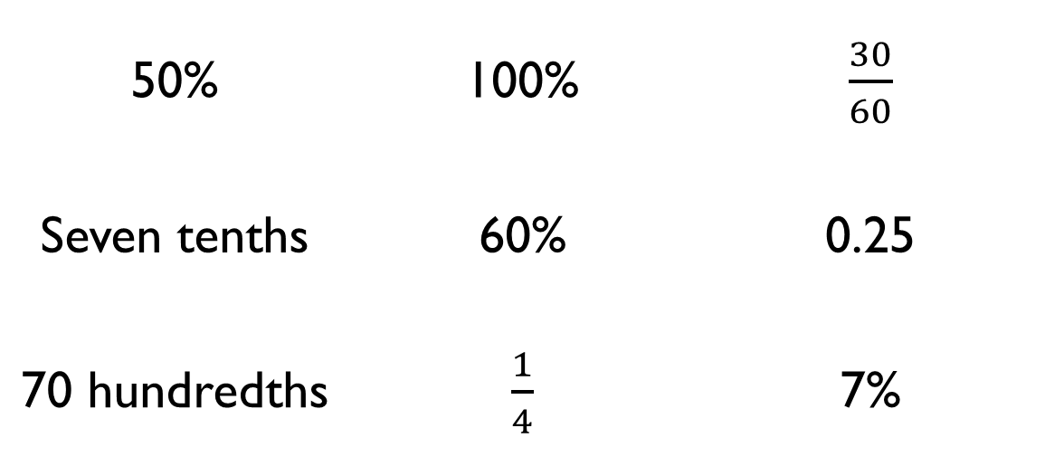
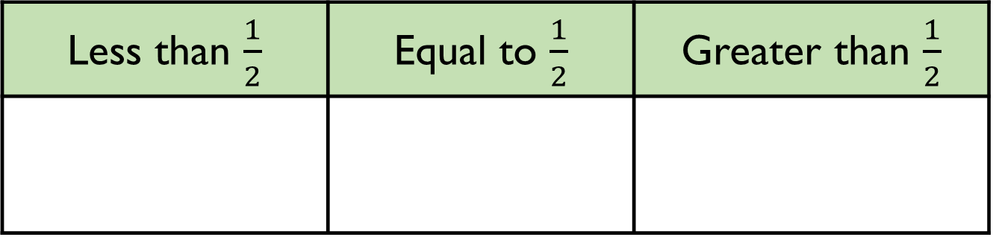
Sort the fractions, decimals and percentages into the correct column.
50% | 100% | $\frac{30}{60}$
Seven tenths | 60% | 0.25
70 hundredths | $\frac{1}{4}$ | 7%
Less than $\frac{1}{2}$ | Equal to $\frac{1}{2}$ | Greater than $\frac{1}{2}$

Slide 27
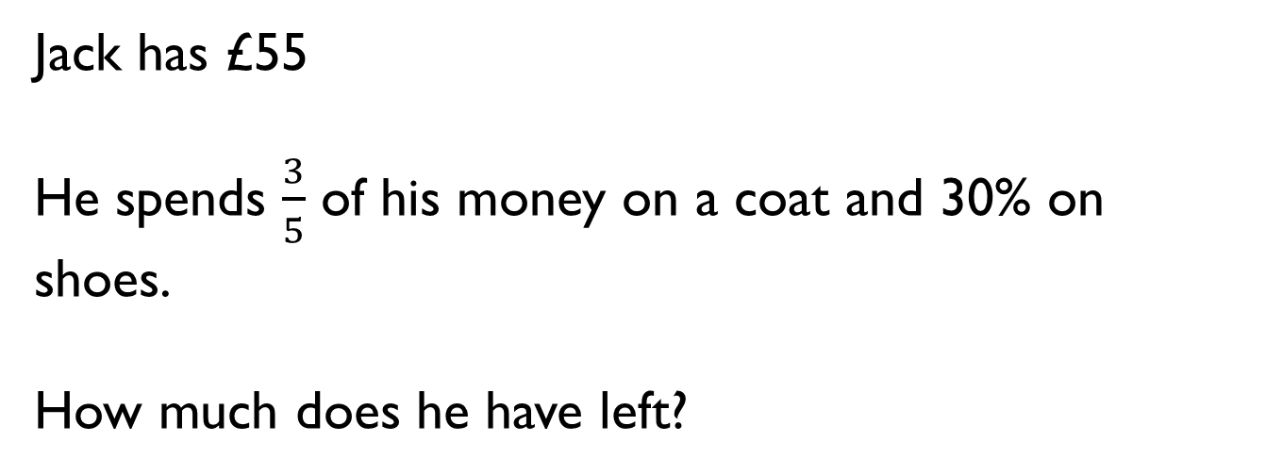
Jack has £55
He spends $\frac{3}{5}$ of his money on a coat and 30% on shoes.
How much does he have left?

Slide 28
Tommy is playing a maths game.
Here are his scores at three different levels.
Level A – 440 points out of 550
Level B – 210 points out of 300
Level C – 45 points out of 90
At which level did he have a higher success rate?

