Slide 1


Slide 2
Aim
I can investigate thermal conductors and insulators.
Success Criteria
I can identify materials that are thermal conductors and insulators.
I can explain what thermal conductors and insulators are.
I can give reasons for the uses of thermal conductors and insulators.

Slide 3
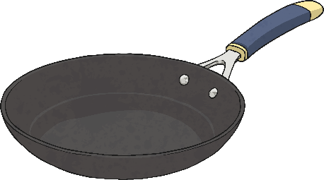
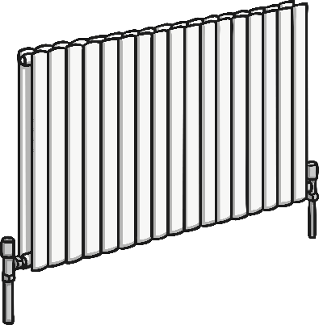
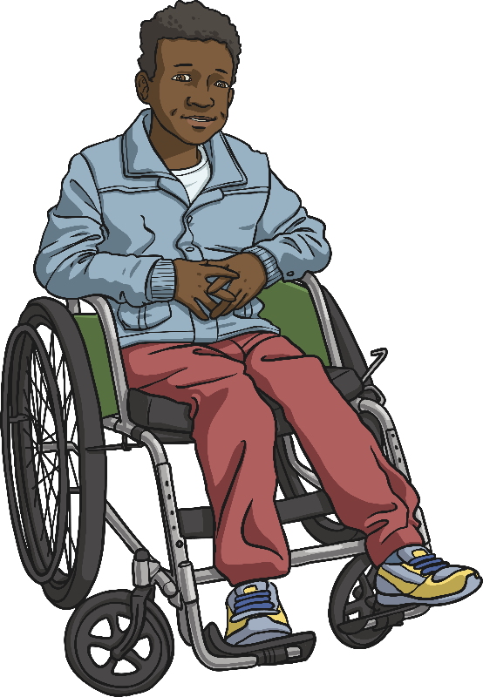
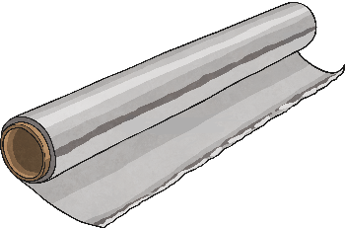
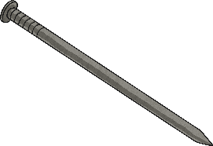
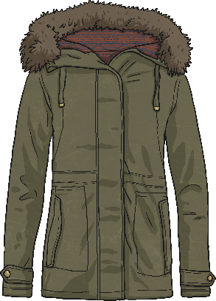
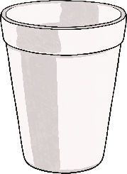
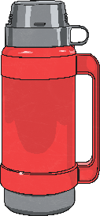
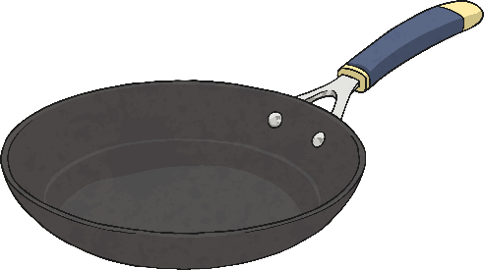
Sorting Materials
Mason has sorted these materials into two groups.
pan
pan handle

Slide 4
Sorting Materials
Can you identify the two groups that he has sorted them into?
pan
pan handle

Slide 5
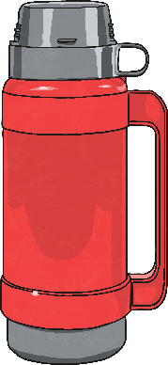
Sorting Materials
Did you figure it out?
  Mason has sorted the materials into thermal conductors and insulators.
Thermal Conductors
Thermal Insulators
pan
pan handle

Slide 6

Thermal Conductors and Insulators
Thermal Conductors
Thermal Insulators
Heat can travel easily through thermal conductors.
Metals are good thermal conductors, as they allow heat to move through them.
Thermal conductors are used to make items that need heat to travel through them, like a pan or a radiator.
Thermal insulators do not let heat travel through them easily.
Some fabrics, wood and plastics are good thermal insulators.
Thermal insulators can keep heat out or in. For example, a vacuum flask stops heat from the air travelling through to the food or drink inside, keeping it cool. A coat stops the heat from your body travelling through to the air outside, keeping you warm.
Did you know?
Heat always travels from a warmer area to a cooler one.

