Slide 1


Slide 2
Aim
I can compare materials according to their properties.
Success Criteria
I can describe a material’s properties.
I can explain the uses of different materials based on their properties.
I can sort and compare materials according to their properties.

Slide 3
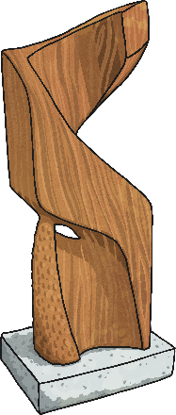

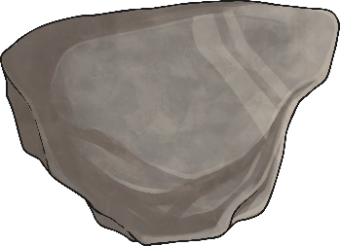
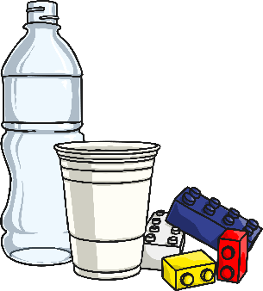

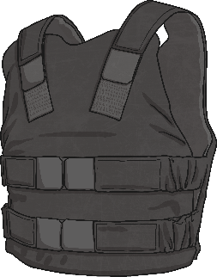
Describing Materials
Any substance that is used to
make something is a material.
Natural materials such as stone, wood and cotton are used or worked with in the way they are found in nature.
Synthetic or human-made materials are made from natural materials, but are altered with the help of heat or chemicals. Some examples include plastics,
polyester and Kevlar.
Natural
Human-made

Slide 4


Describing Materials
Watch this video and read about types of materials- https://www.bbc.co.uk/bitesize/topics/z4339j6/articles/zx8hhv4
Around your home, you will have many different materials.
You task - Can you identify the different materials just by feeling them?
While you have a go at this activity, think of words to describe each material, such as hard, soft, cold or rough.

Slide 5

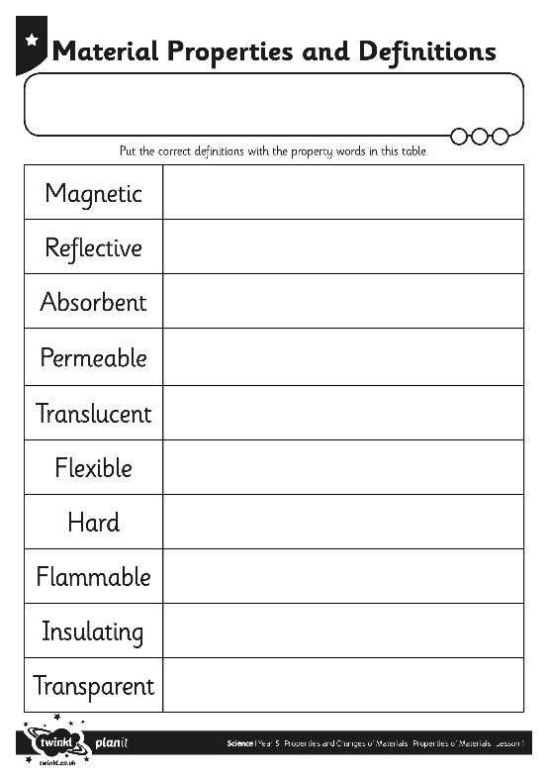
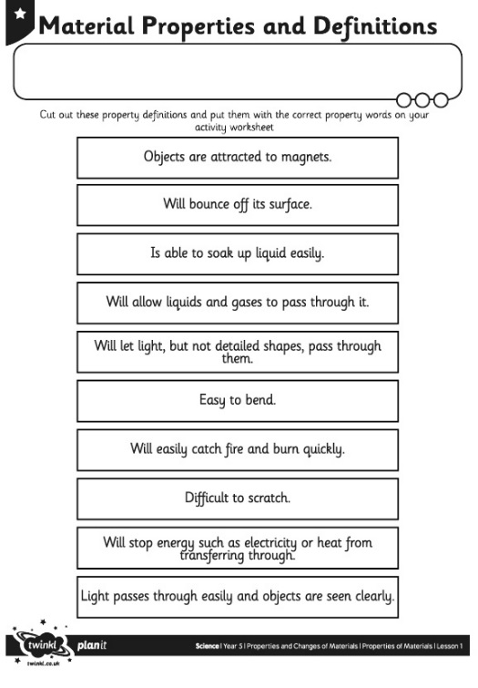
Properties – Your task
The words used to describe a material are known as its properties.
Each material has its
own set of properties.
These properties make different materials useful for
different purposes.
Can you match the properties with their definitions on your Material Properties
Activity Sheet?
(*-easier, ***-most difficult)

Slide 6

Using Materials
Why is it useful to know the properties of a material?
  It is useful because if you know the properties of a material, you can then choose the best material for a purpose.
  Look again at the materials around your home. Why was each material chosen to make these things?
Talk to a family member about your ideas.

Slide 7
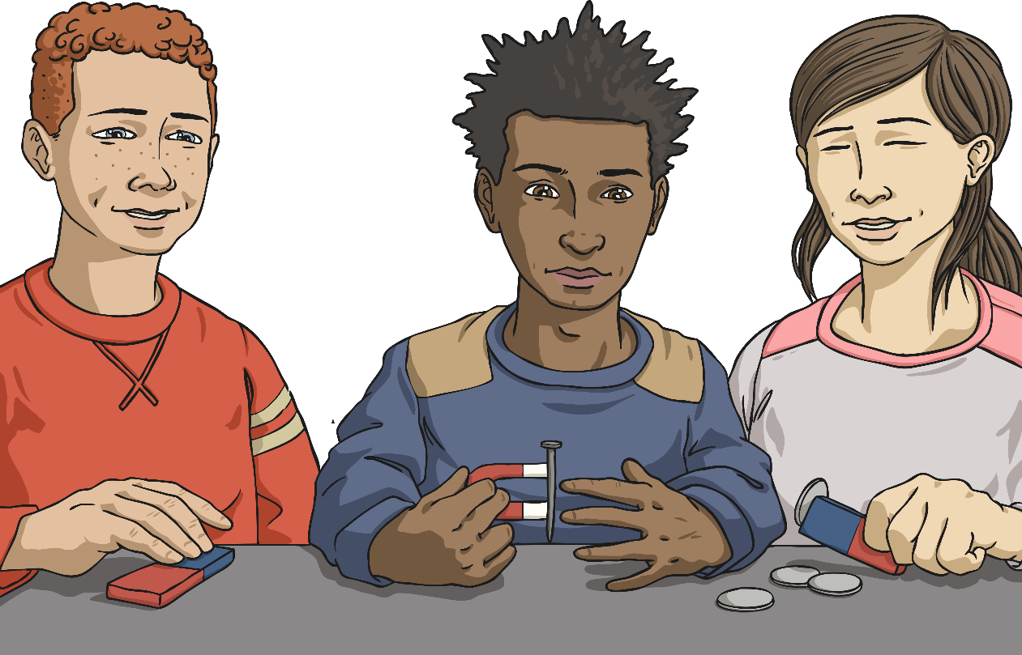
Testing Properties
To find out which properties a material has, they have to be tested.
You are going to test several different materials to find their properties.
You will test for:
magnetism;
hardness;
transparency;
flexibility;
permeability.
*If you do not have some of the resources required, please just leave that test out.

Slide 8
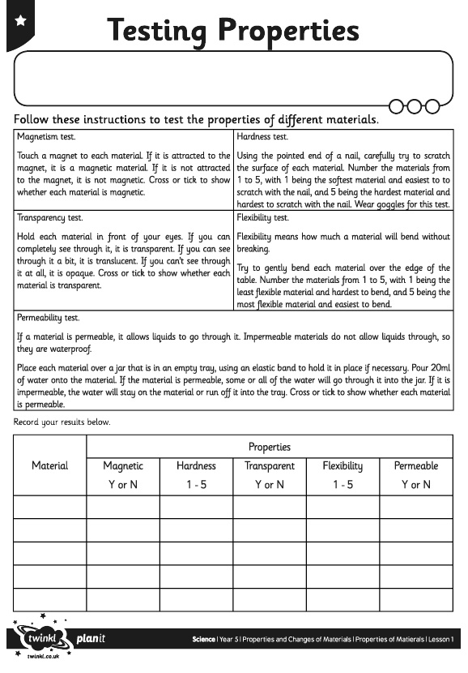

Testing Properties
Follow the instructions for each test, and try out each test with each material.
Complete your Testing Properties Activity Sheet with your results.
(*-easier, ***-most difficult)

Slide 9

Aim
I can compare materials according to their properties.
Success Criteria
I can describe a material’s properties.
I can explain the uses of different materials based on their properties.
I can sort and compare materials according to their properties.

