Slide 1
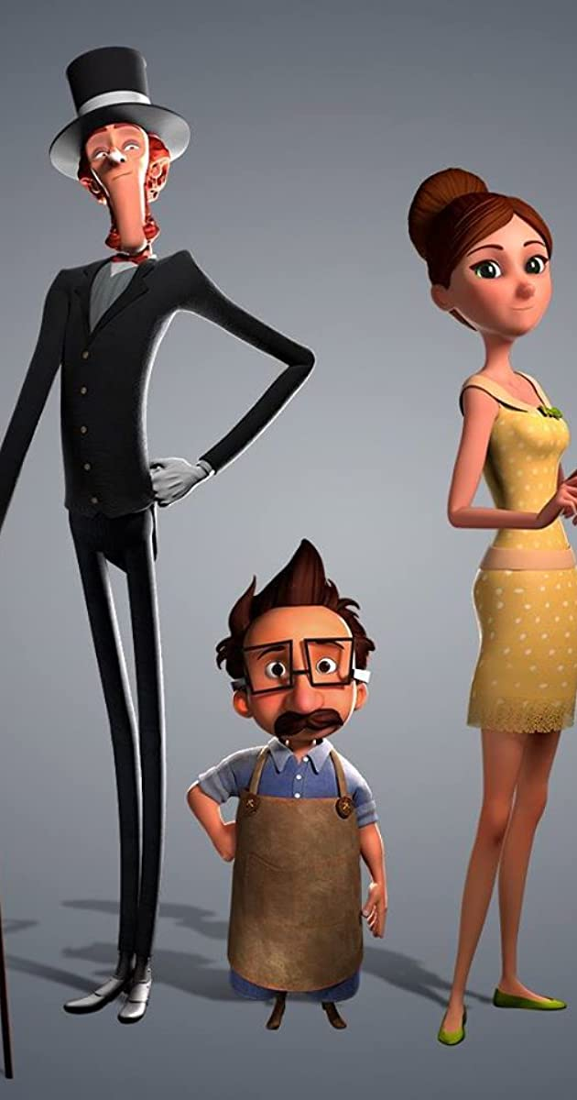
The Little Shoemaker
Lesson 6

Slide 2
Can I write a fairy tale?
Now that you have a plan, what else can help you with your story?

Slide 3
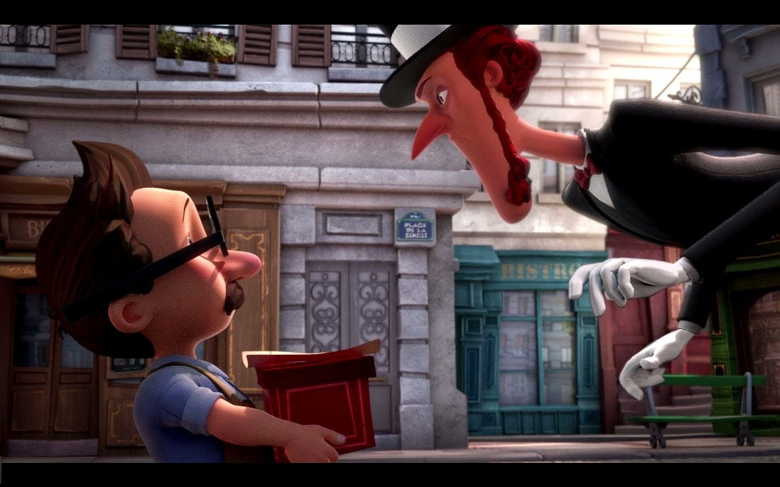
Character descriptions!
In lesson 1, you created some character descriptions. These will be important as they let your audience know WHO the characters are!

Slide 4
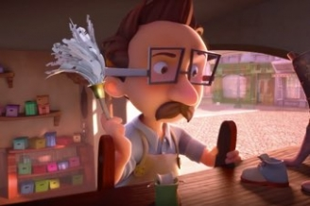
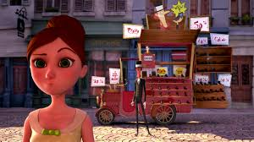
Dialogue (speech)
Could you use some of the dialogue you created in lesson 2 in your story? What other dialogue can you include?

Slide 5

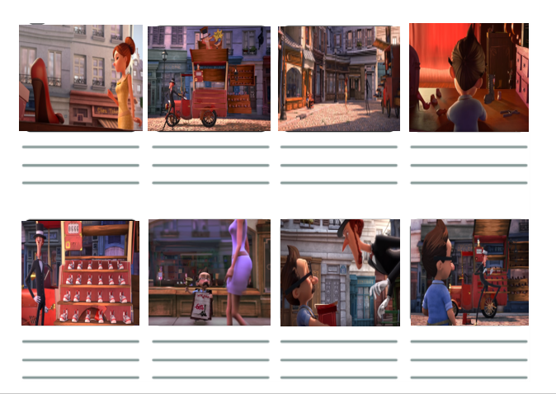
Remember this?
I can use my storyboard to help me!
There is Shoe shop in Paris…

Slide 6
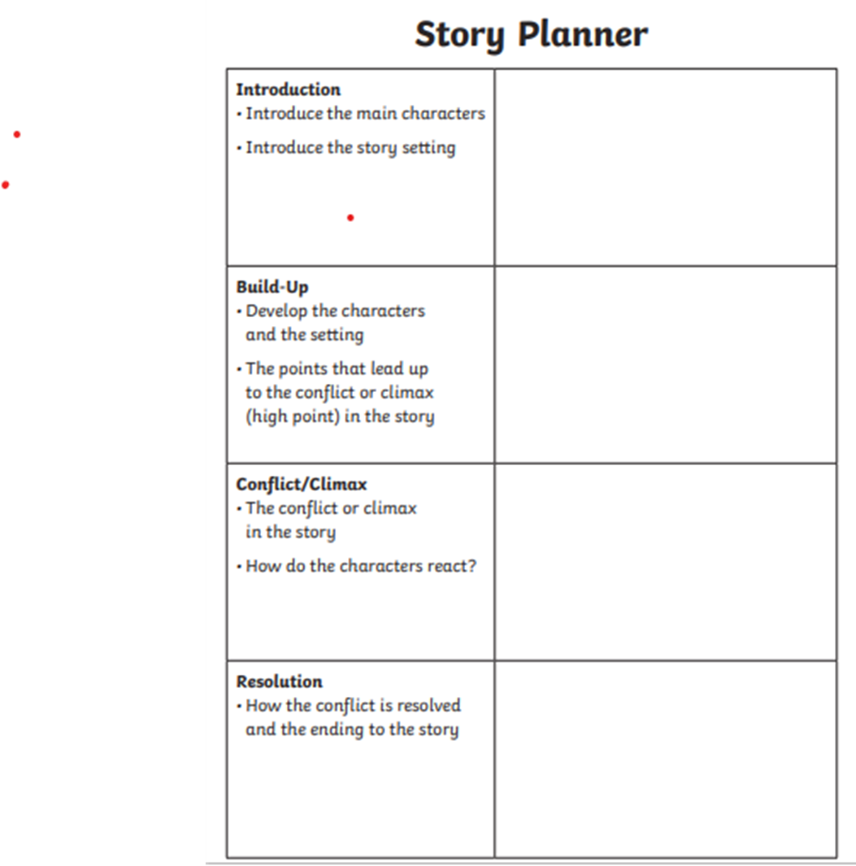
You can also use your plan!

Slide 7
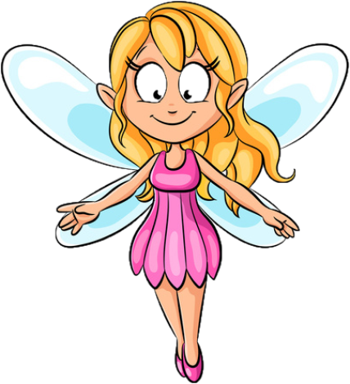
Remember the fairy tale features!
It DOES NOT need to include a fairy!
Use some form or variation of "Once upon a time"
Fantasy or make-believe elements
Enchanted setting - can include forests, castles, water or kingdoms
Clearly defined good and evil characters
Magical elements
Characters take on unusual forms (giants, witches, dwarfs, talking animals)
Groups of 3 (objects, people or events)
Clearly defined problem, climax and resolution
Most often they have a happy ending

Slide 8
What else can help with my writing?
Alan Peat sentences - The more the Shoe Maker tried, the more difficult it became to sell his shoes.
Year 5/6 word list

Slide 9
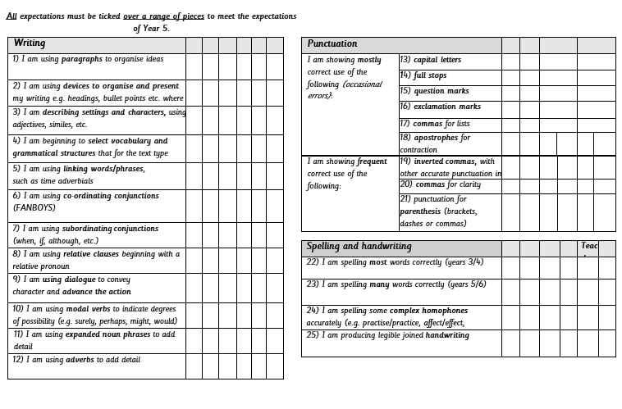
Can I write the story of the Little Shoemaker?
You can produce this on paper or on a word document. It’s completely up to you!
Use the year group expectations to check off what features you have included!

Slide 10
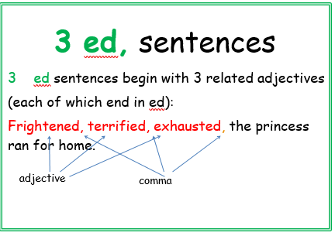
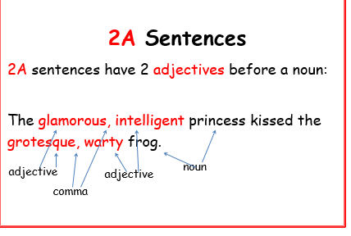
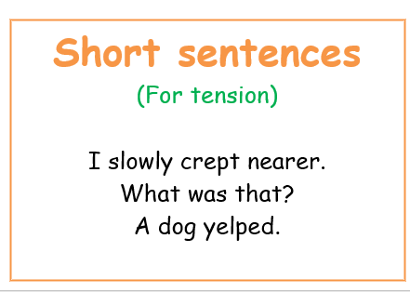
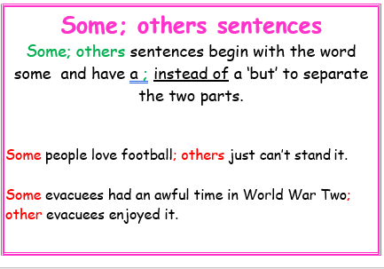

Slide 11


